Slide 1
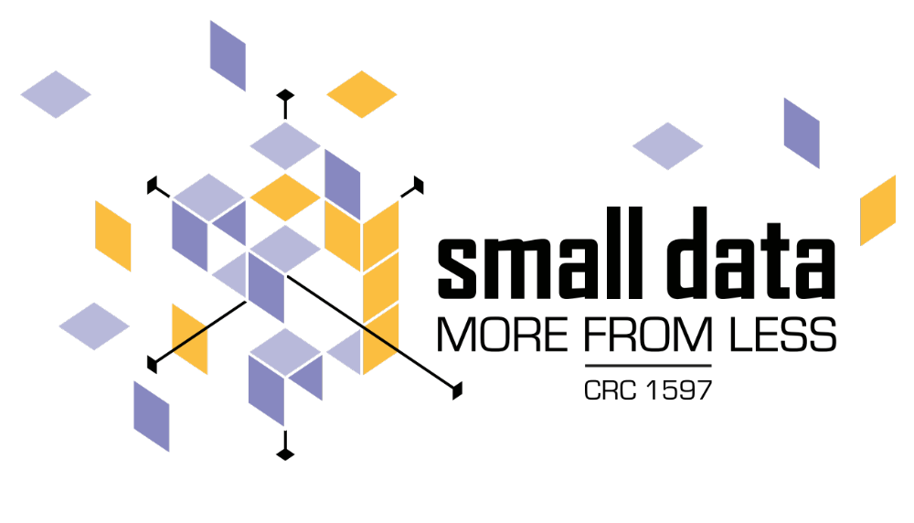
Assessing Multimodal Chronic Wound Embeddings with Expert Triplet Agreement
Fabian Kabus¹*, Julia Hindel²*, Jelena Bratulic², Meropi Karakioulaki³, Ayush Gupta², Christina Has³, Thomas Brox², Abhinav Valada², Harald Binder¹
¹ Institute of Medical Biometry and Statistics (IMBI), Medical Center, University of Freiburg
² Department of Computer Science, Faculty of Engineering, University of Freiburg
³ Department of Dermatology, Medical Faculty and Medical Center, University of Freiburg
* Equal contribution

Slide 2
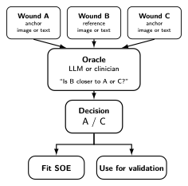
Introduction
Recessive dystrophic epidermolysis bullosa (RDEB)
Affects ~3.5–20.4 people per million
Chronic, non-healing wounds, extreme skin fragility, recurrent infections, elevated risk of squamous cell carcinoma
Highly heterogeneous: tissue composition, inflammation, depth, and border morphology
Dataset: 21 patients, 53 clinical images (different body parts), 120 individually annotated wounds

Slide 3
Model overview

Slide 4
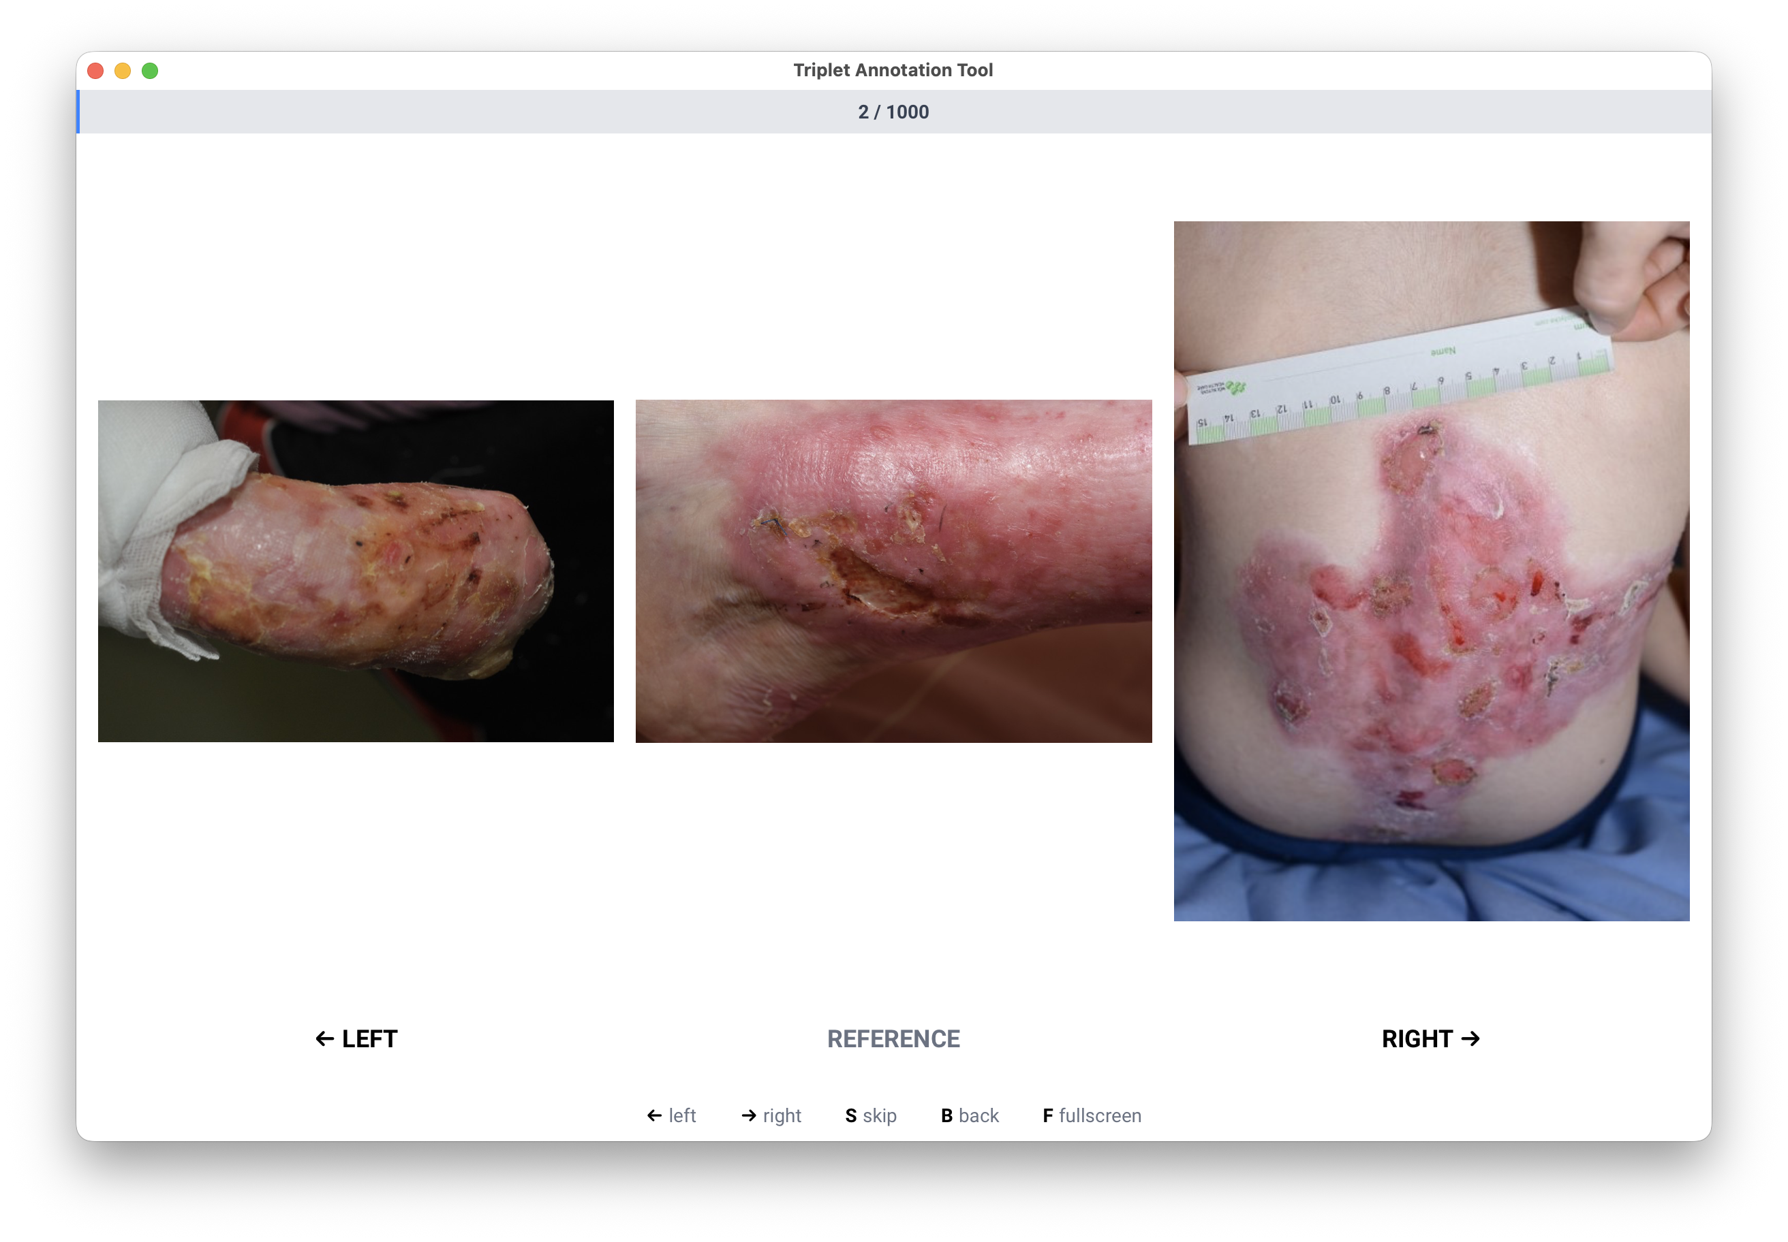
Expert triplet annotation

Slide 5
Expert triplet embedding

Slide 6
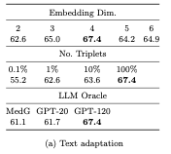
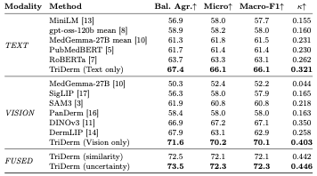
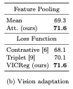
Quantitative results

Slide 7
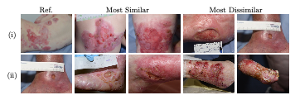
Qualitative results

Slide 8

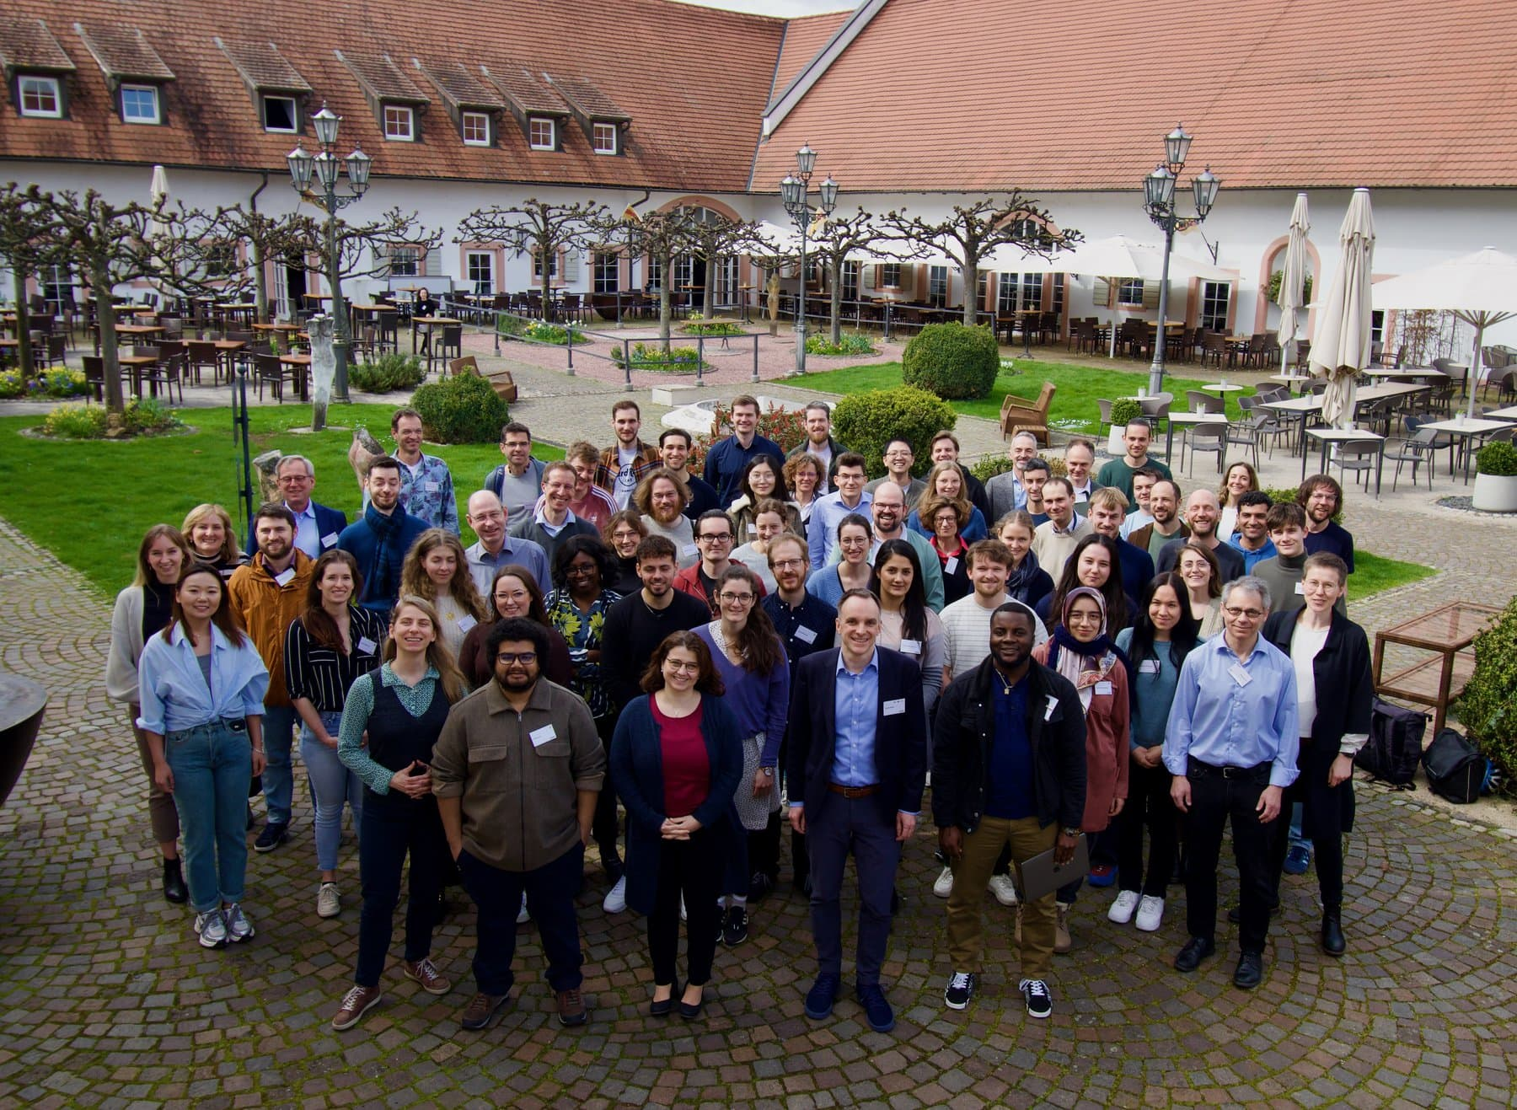
Summary
fabian.kabus@uniklinik-freiburg.de
Triplet questions are a useful tool to query similarity relationships from clinical experts.
They also work for LLMs, improving agreement with clinical expert at the cost of computation.
Finetuning the vision backbone improves agreement as well.
CRC Small Data

