Slide 1
From Majority to Minority: A Diffusion-based Augmentation for Underrepresented Groups in Skin Lesion Analysis
Janet Wang
​
Joint-work with Yunsung Chung, Zhengming Ding, and Jihun Hamm.
​

Slide 2
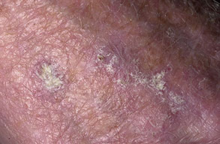
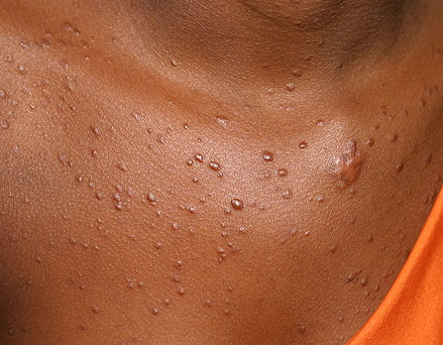
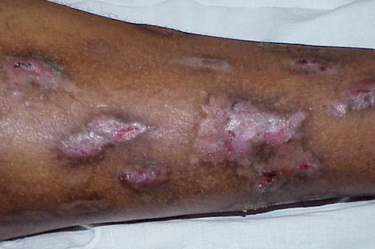
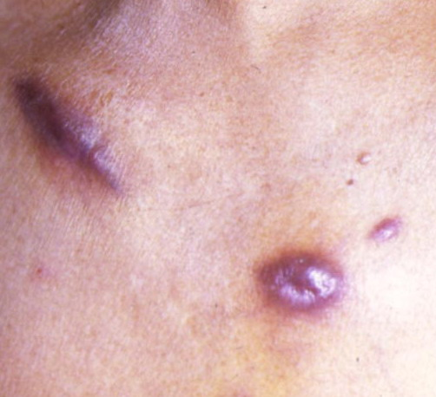
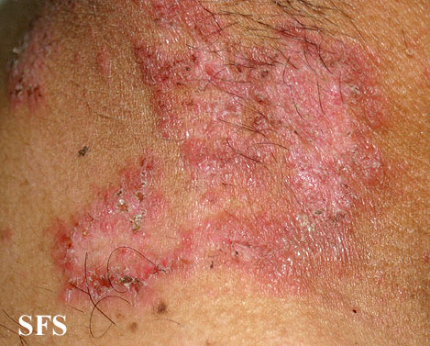
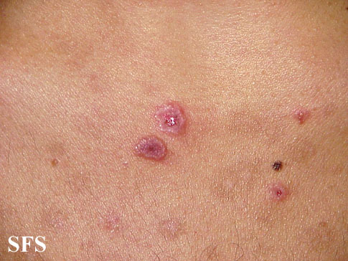
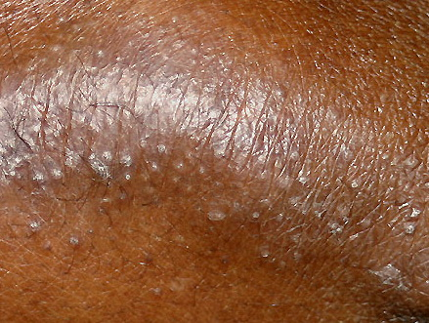
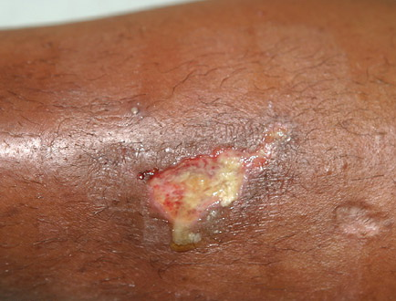
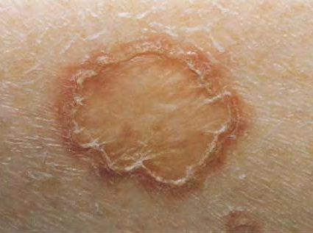
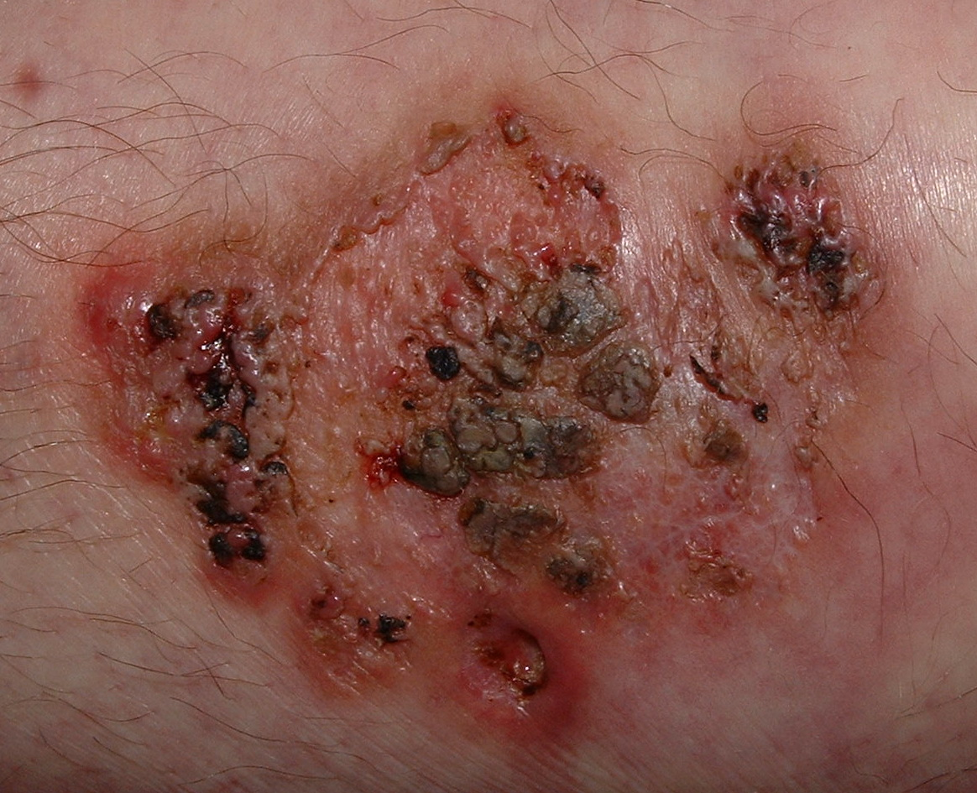
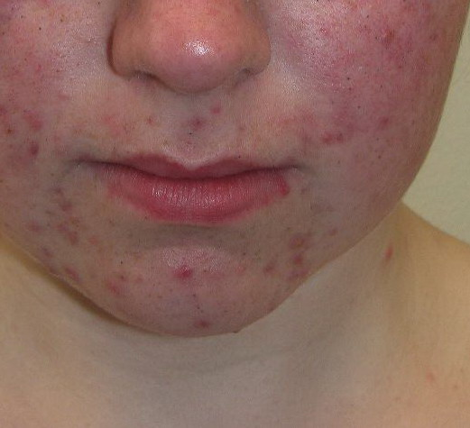
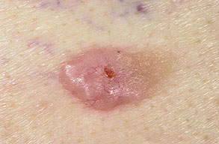
Motivation
Example: Fitzpatrick17k
Clinical photos with FST label
Source FST I-II, target FST V-VI
FST
I
II
III
IV
V
VI
Basal Cell Carcinoma Psoriasis
Neutrophilic Dermatoses
…..
…..
…
predict
Test set skin type distribution
train
+
Train set skin type distribution
Notes:
Introduce problem setting, task and dataset

Slide 3
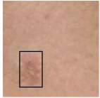
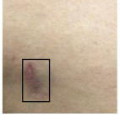
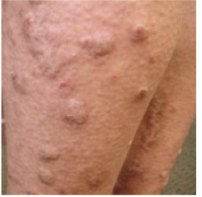
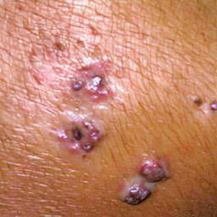
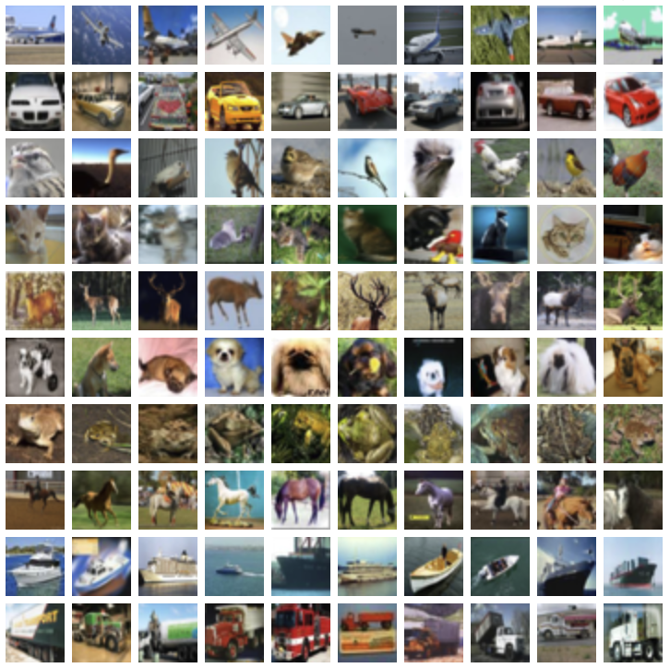
Motivation
Generative Adversarial Network
Pre-defined semantic map:
- encodes target skin type
- guides diverse generation
- sampled from existing data
generate
Diffusion Model
generate
An image of {prurigo nodularis} on a {dark-skinned} individual
pre-train
diversity beyond training set
Ghorbani, Amirata, et al. "Dermgan: Synthetic generation of clinical skin images with pathology." Machine learning for health workshop. PMLR, 2020.
Notes:
GAN vs. diffusion models; image transformation

Slide 4
Motivation
Unresolved problems:
Cross-group generation from majority groups by DMs
Synthetic data comparable to or outperform real data
Existing Works | Dataset | Skin Type Distribution
Sagers, Luke W., et al.¹ | DDI, Fitzpatrick17k | Skewed towards light skin
Sagers, Luke W., et al.² | Fitzpatrick17k | Skewed towards light skin
Akrout, Mohamed, et al.³ | Internal dataset | Unknown
Ktena, Ira, et al.⁴ | Internal dataset | Unknown
1.Sagers, Luke W., et al. "Augmenting medical image classifiers with synthetic data from latent diffusion models."
2.Sagers, Luke W., et al. "Improving dermatology classifiers across populations using images generated by large diffusion models."
3.Akrout, Mohamed, et al. "Diffusion-based data augmentation for skin disease classification: Impact across original medical datasets to fully synthetic images."
4.Ktena, Ira, et al. "Generative models improve fairness of medical classifiers under distribution shifts."
Notes:
Other DM papers; unsolved problems

Slide 5
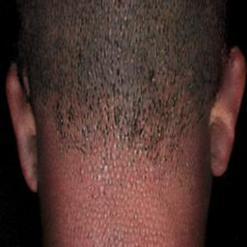
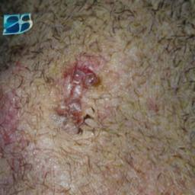
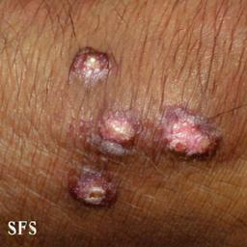
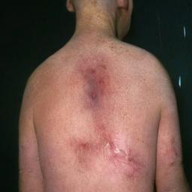
Motivation
Basal Cell Carcinoma Psoriasis
Neutrophilic Dermatoses
…..
…..
predict
…
train
generate
knowledge about skin type
synthetic
+
pre-train
fine-tune
real
condition-specific information
Notes:
Introduce pipeline;

Slide 6
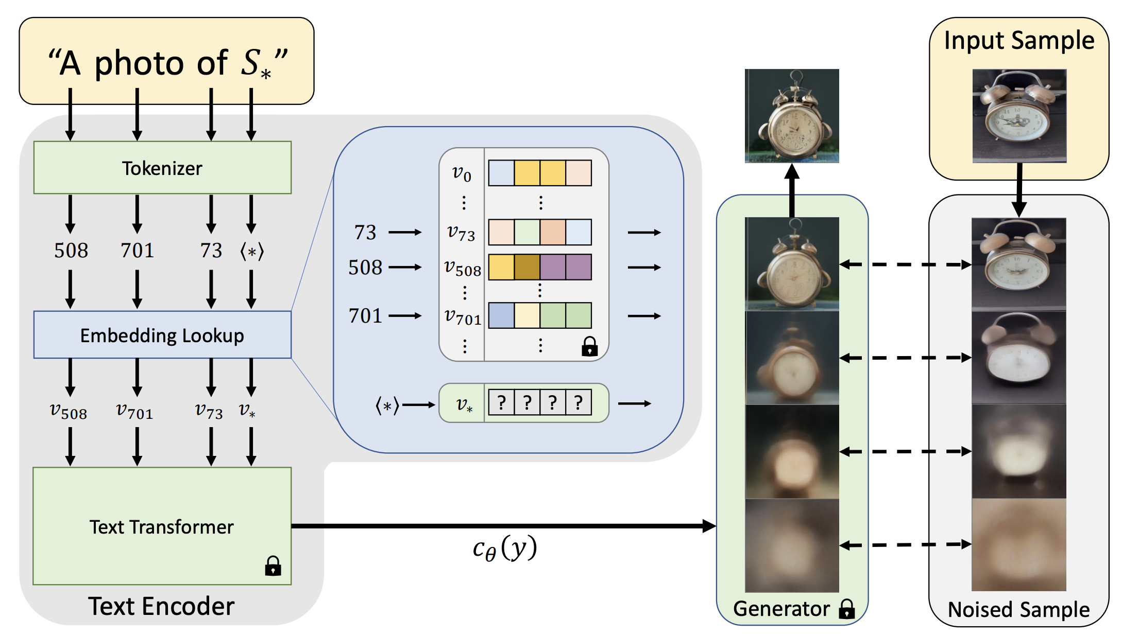
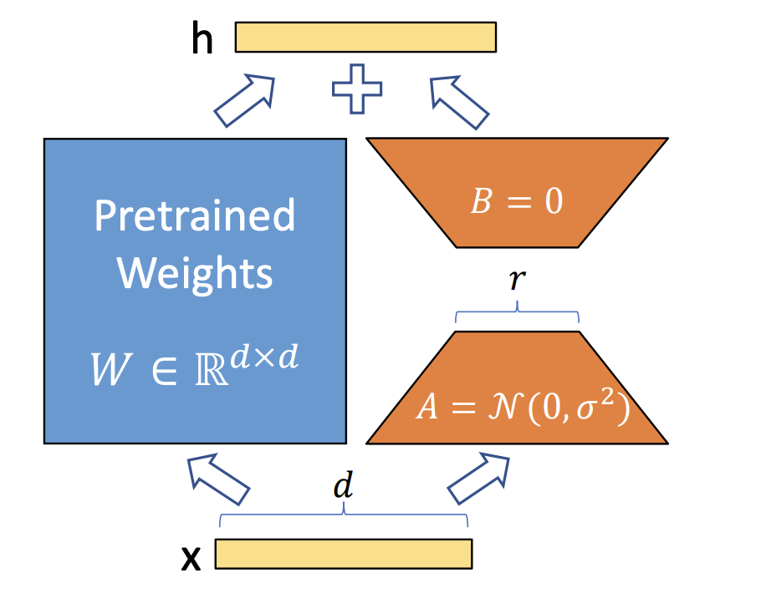
Method
Textual Inversion by Gal, Rinon, et al.
Low-rank Adaptation by Hu, Edward J., et al.
Gal, Rinon, et al. "An image is worth one word: Personalizing text-to-image generation using textual inversion." arXiv preprint arXiv:2208.01618 (2022).
Hu, Edward J., et al. "Lora: Low-rank adaptation of large language models." arXiv preprint arXiv:2106.09685 (2021).
Notes:
Main finetuning techniques

Slide 7
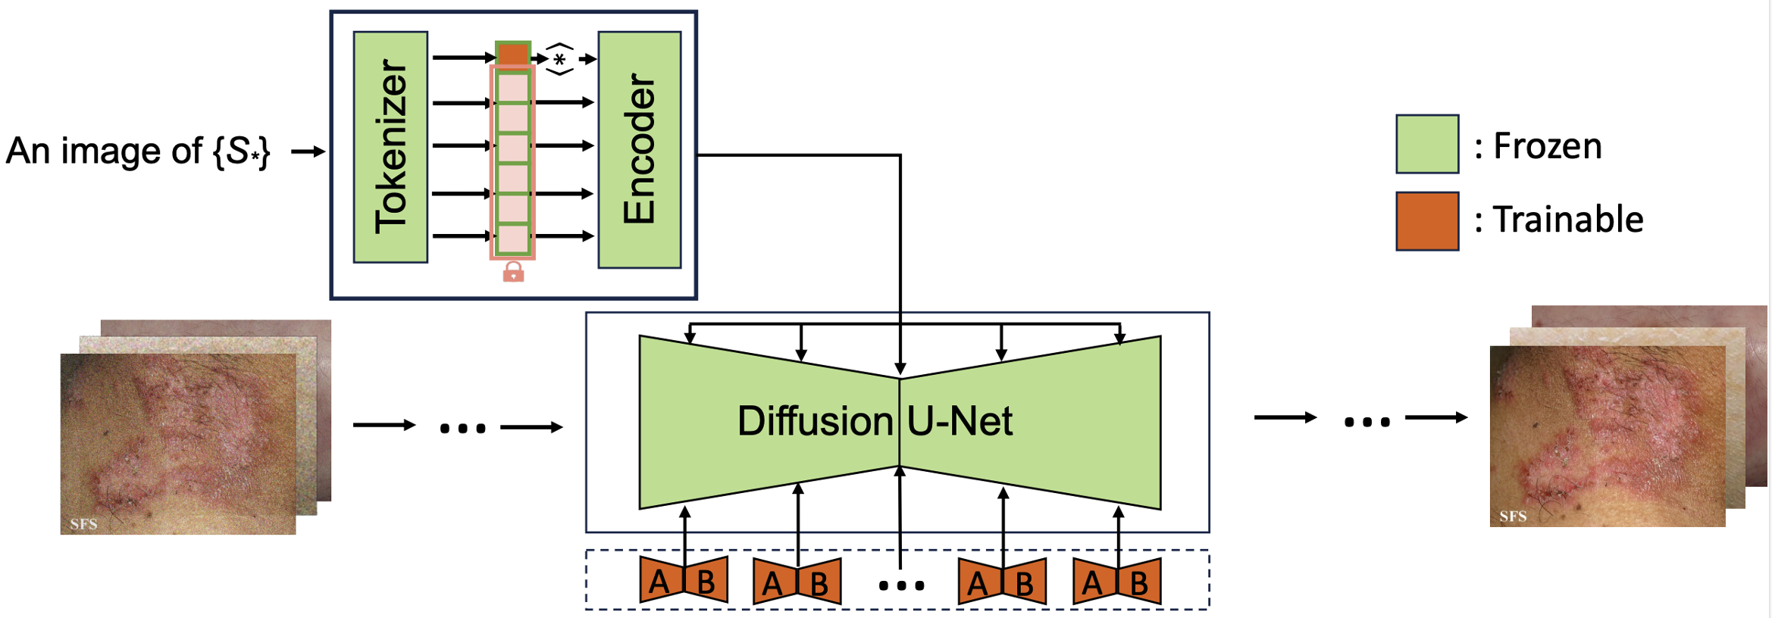
Method
Fine-tune Latent Diffusion Models
Integrate Textual Inversion with LoRA in latent space
Notes:
How to integrate TI and LoRA to finetune DM

Slide 8
Method
Text-to-image
An image of {S*} on the skin of {group attribute}
generate
Fine-tuned
Image-to-image
generate
An image of {S*} on the skin of {group attribute}
Fine-tuned
Notes:
Img-to-img vs txt-to-img

Slide 9
Setting Overview
Augmentation Pipeline
… …
Test set
Investigate 3 settings:
- sensitive attribute distributions
- increasing difficulty
Setting 1
Setting 2
Setting 3
Notes:
Introduce 3 settings

Slide 10
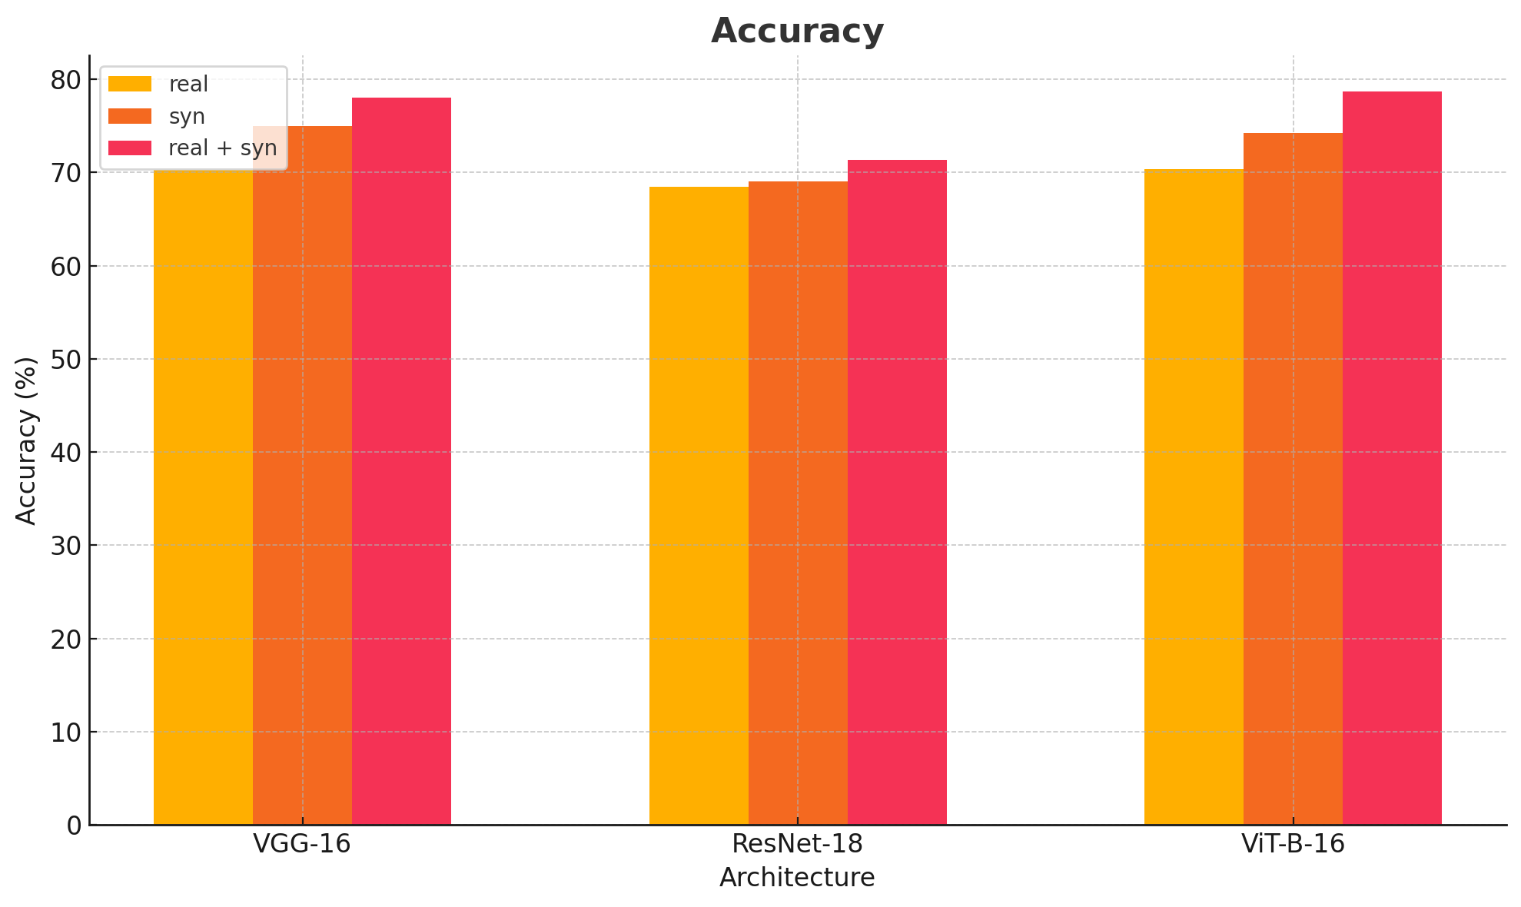
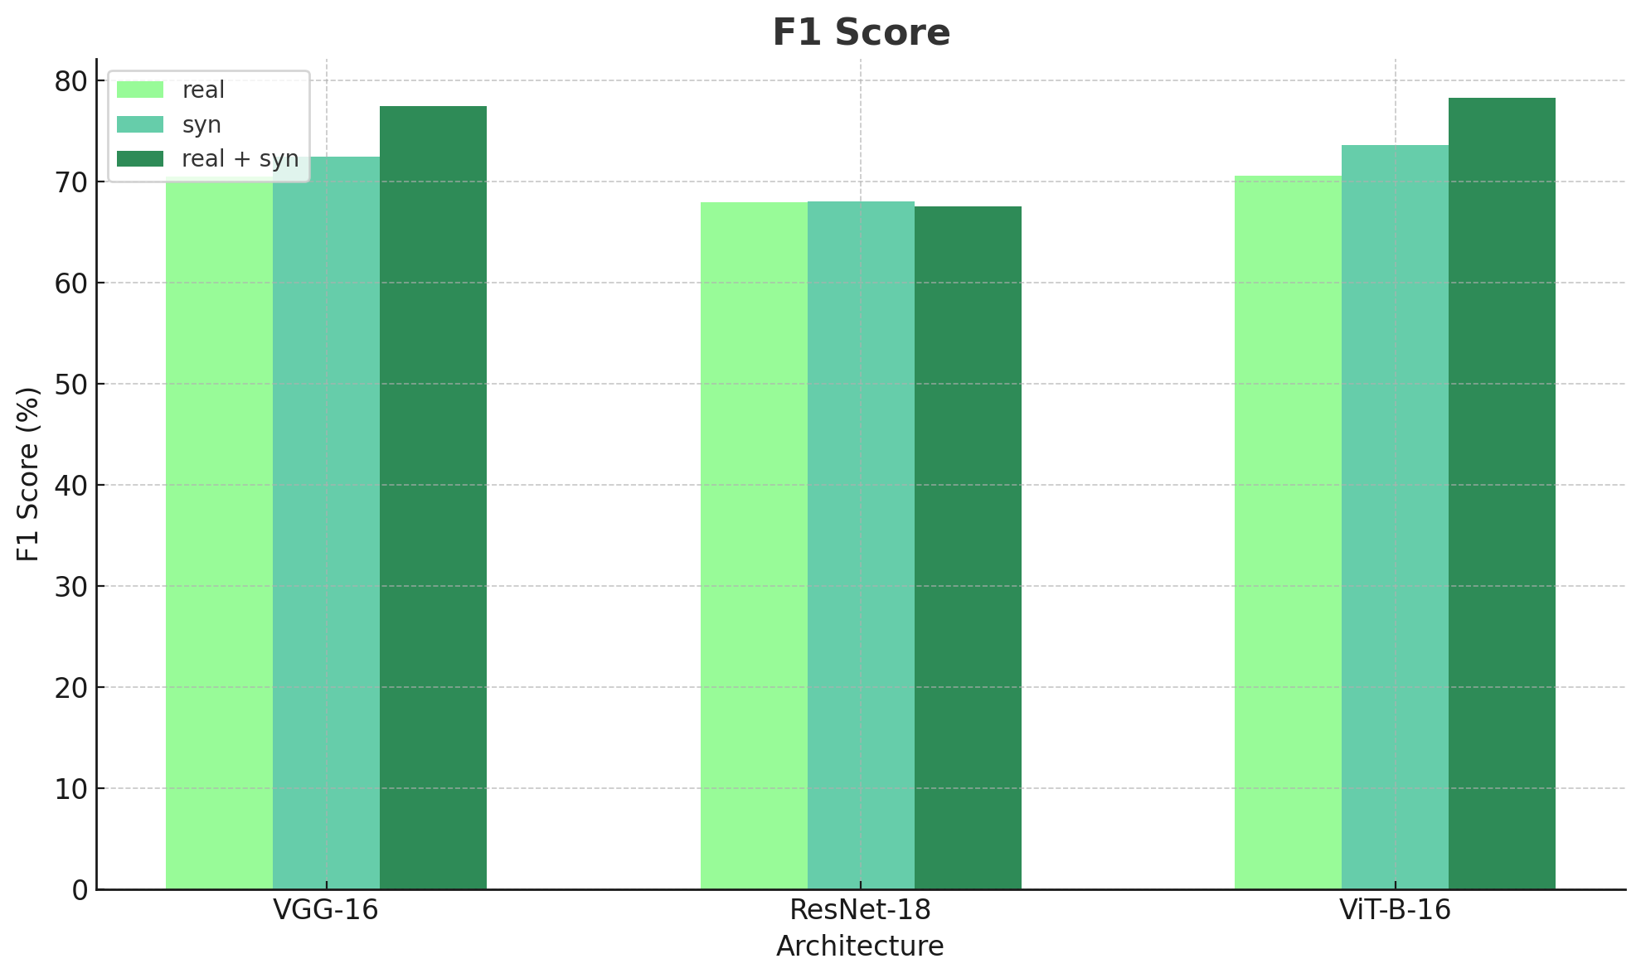
Results - Setting 1
training
test

Slide 11
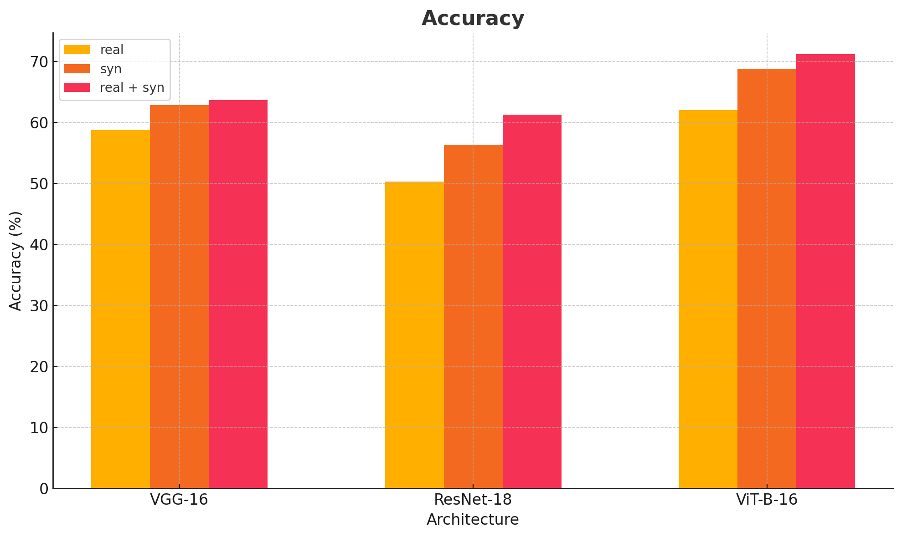
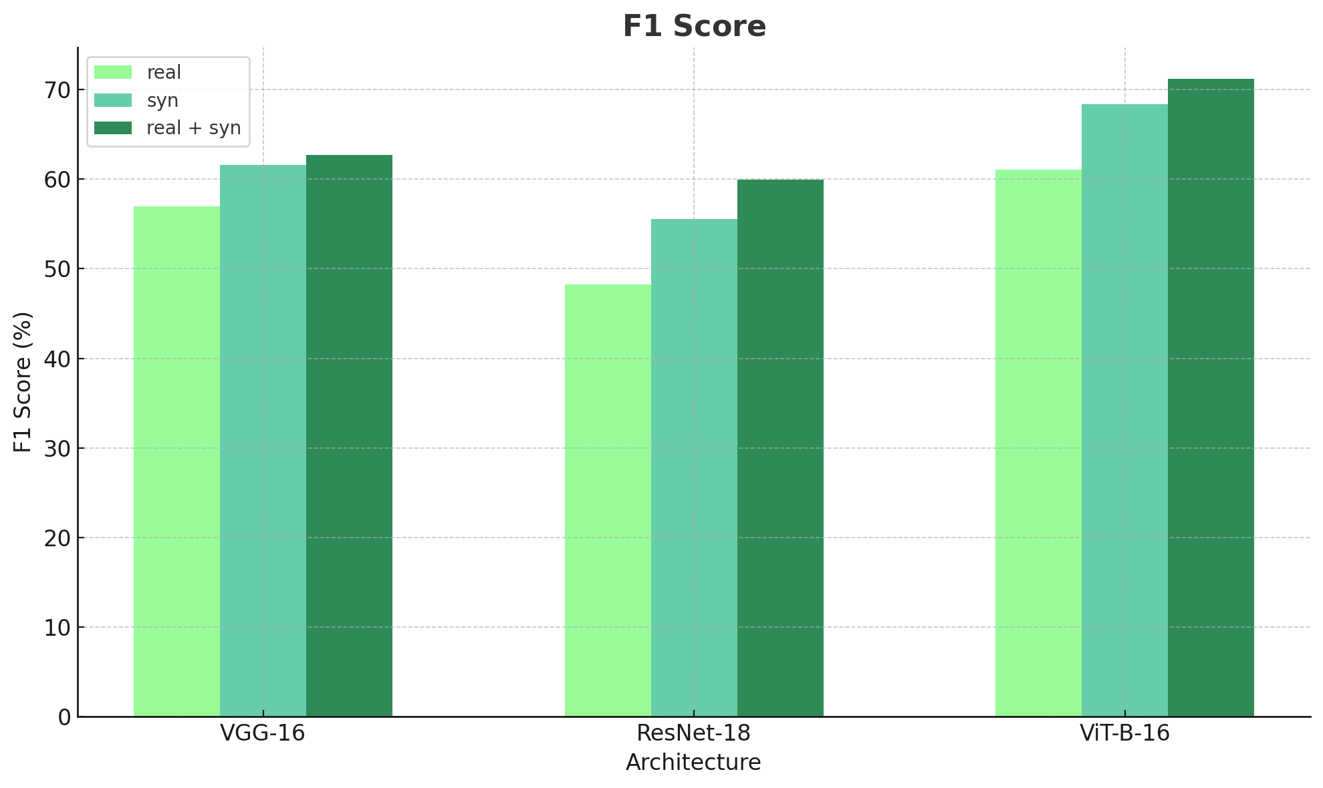
Results - Setting 2
training
test

Slide 12
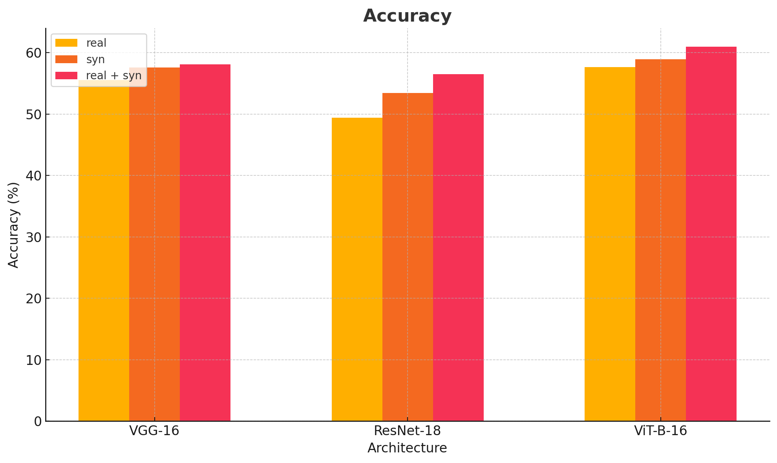
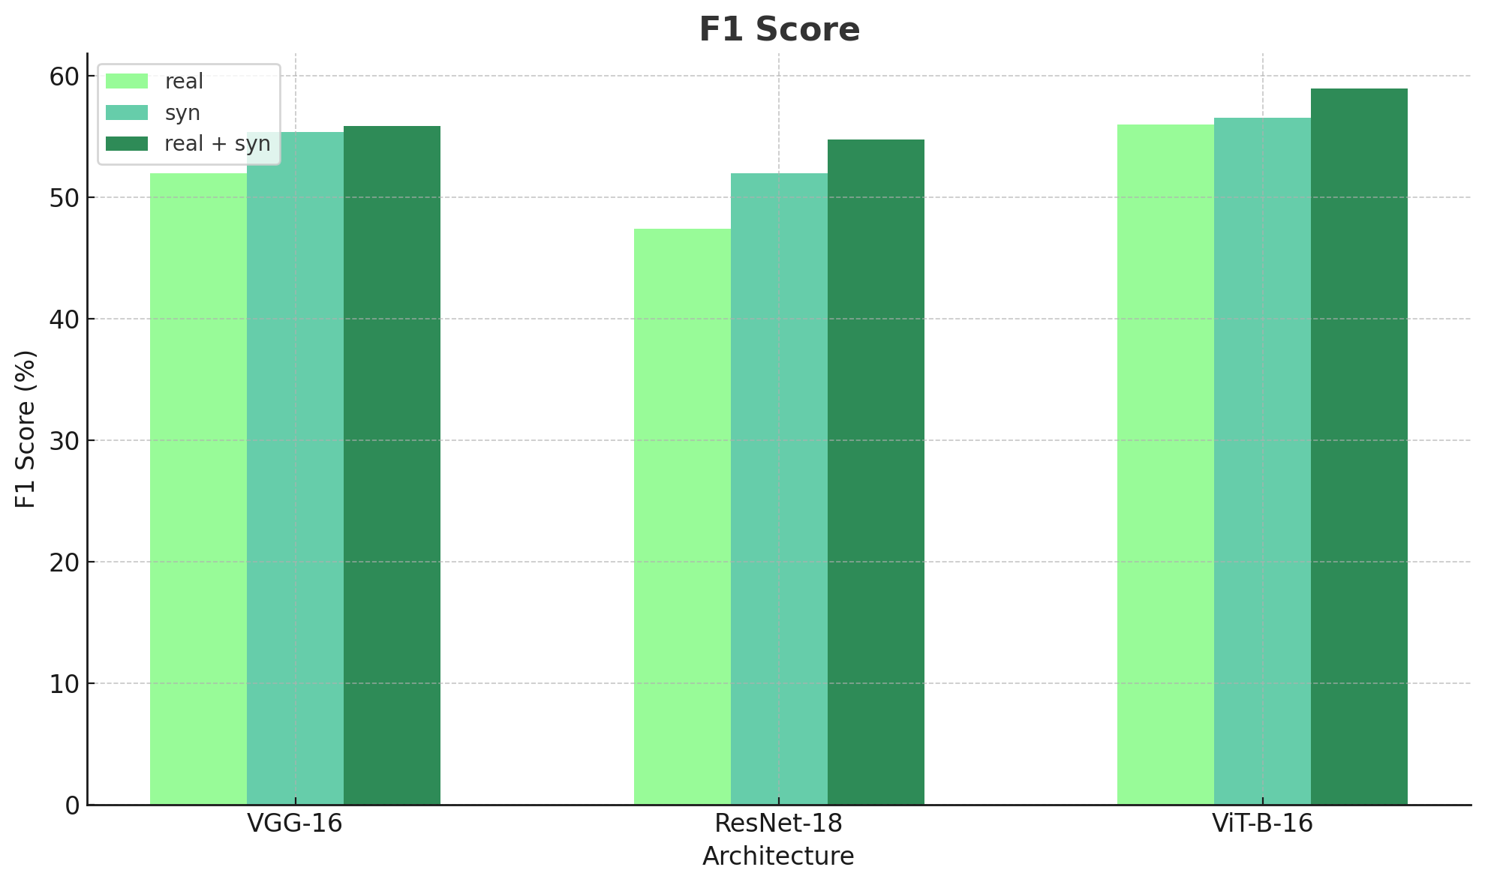
Results - Setting 3
training
test

Slide 13
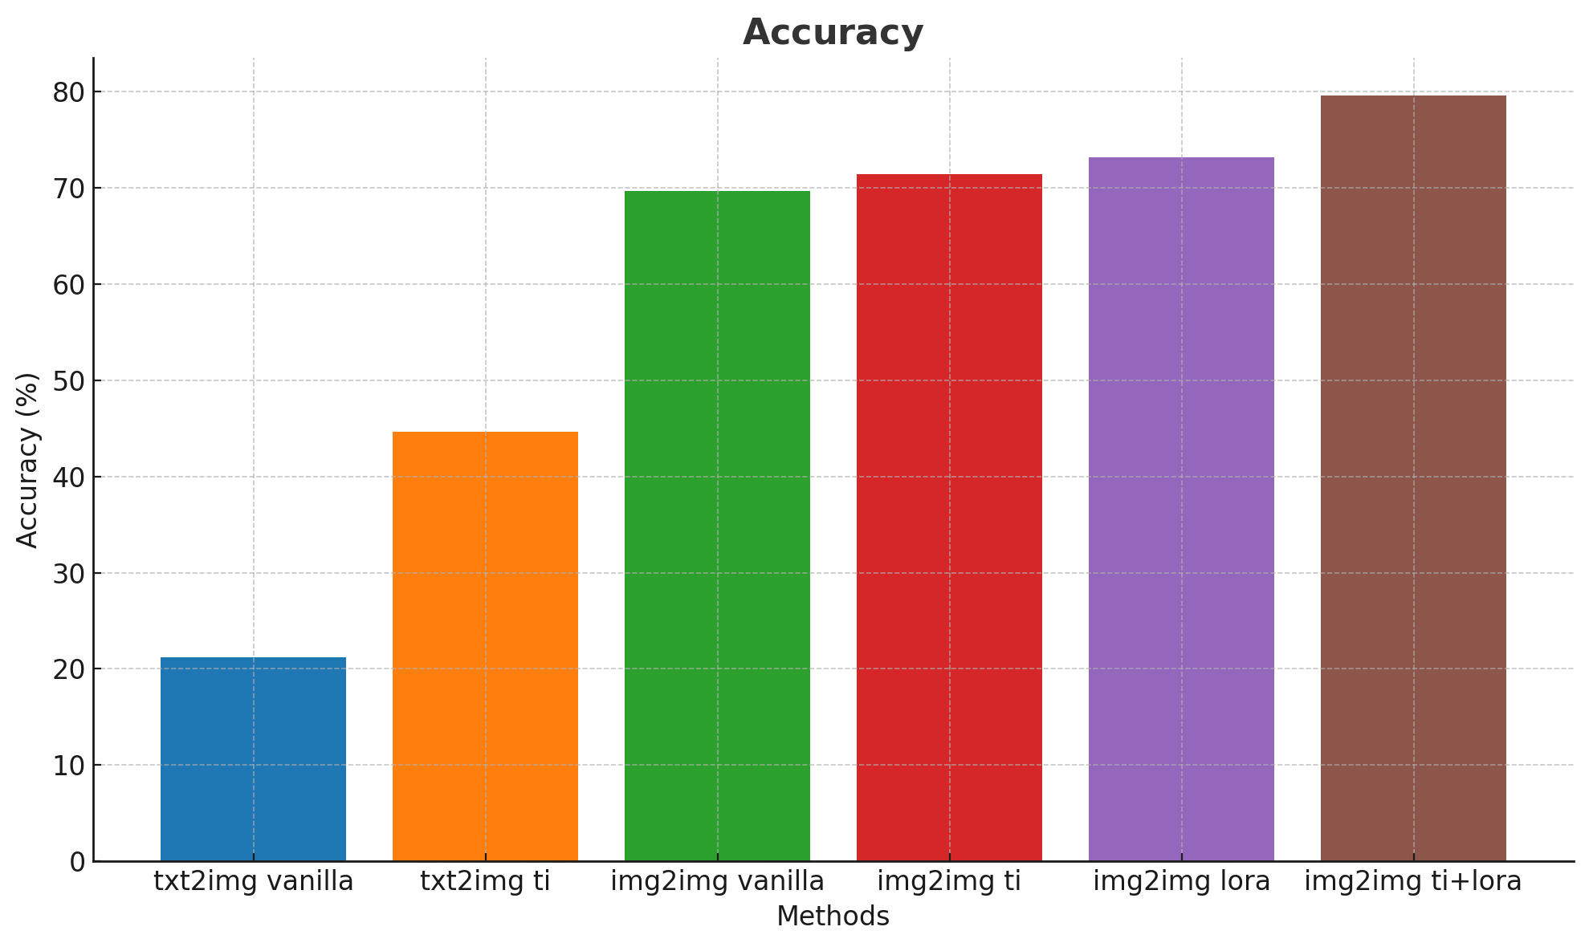
Ablation Study
- Fine-tune vs. Off-the-shelf
- Image-to-image vs. Text-to-Image
- With or Without Textual Inversion/LoRA
Notes:
Validate our design

Slide 14
Qualitative Analysis
Notes:
Direct them to future directions; RLHF

Slide 15
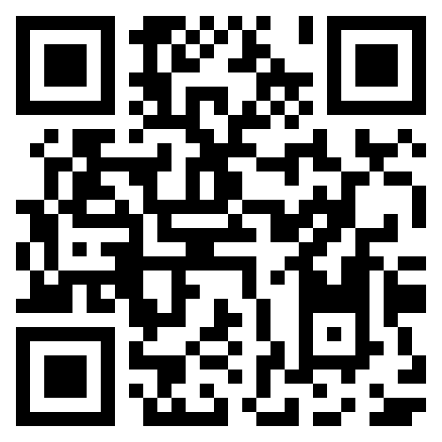
Conclusion & Future Work
Utilizes lesion information from the majority group to generate diverse synthetic images.
Improve the diagnosis on minority skin groups, even without reference data.
In the future:
Lesion-aware fine-tuning.
What types of synthetic images are effective?
Aligning generation with dermatologist’ feedback.
For more details:

