Slide 1
Communication-Efficient Federated Skin Lesion Classification with Generalizable Dataset Distillation
< MICCAI 2023 >
Yuchen Tian¹, Jiacheng Wang¹, Yueming Jin², Liansheng Wang^{1,*}
¹ Department of Computer Science at School of Informatics, Xiamen University, Xiamen, China
² Department of Biomedical Engineering the Department of Electrical and Computer Engineering, National University of Singapore, Singapore
MICCAI 2023
Communication-Efficient Federated Skin Lesion Classification with Generalizable Dataset Distillation, T. Chen
MICCAI2023

Slide 2
CONTENT
PART1: Introduction
PART2: Proposed Method
PART3: Experiments
PART4: Conclusion

Slide 3
● Introduction
Skin Lesion Classification Federated Learning Paradigm:
Upload
Download
Challenges:
Huge communication cost
High risk of privacy leakage
Possible distribution drifts inter clients
Server
Client 1
Client 2
Client m

Slide 4
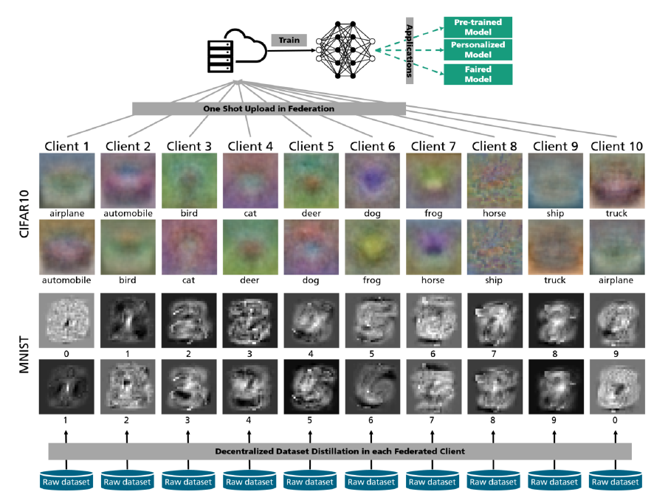
● Introduction
Motivation:
Existing method FedD3 simply distills dataset for each client and uploads synthetic images in a single round.
(a) FedD3

Slide 5
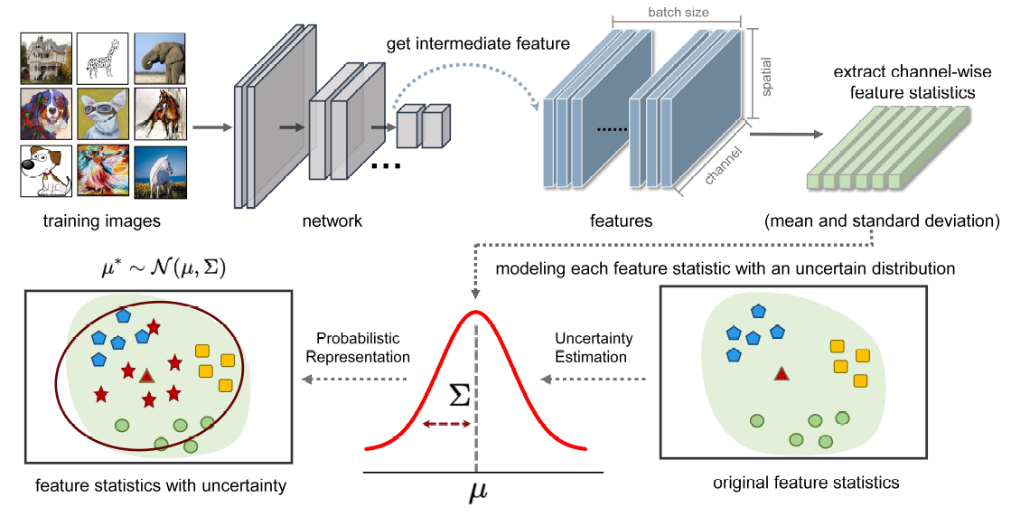
● Introduction
Motivation:
Existing method DSU resamples feature statistics from Gaussian distribution and models each feature statistic with an uncertain distribution.
(b) DSU

Slide 6
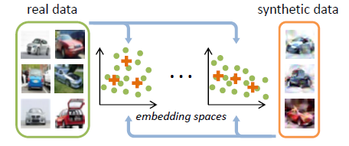
● Introduction
Motivation:
Existing method DM randomly sample real and synthetic data and embed them. DM learns the synthetic data by minimizing the distribution discrepancy between real and synthetic data in embedding spaces.
(c) DM

Slide 7
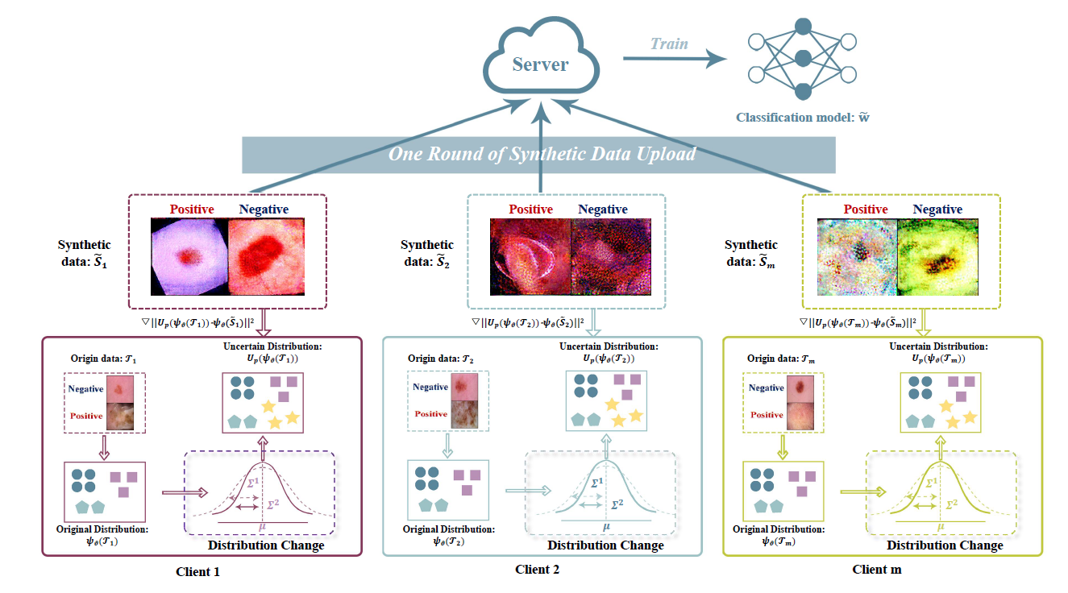
● Proposed Method

Slide 8
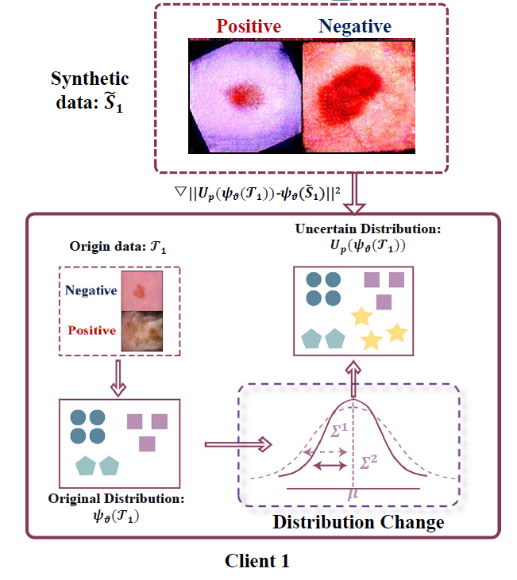
● Proposed Method
Synthetic data: $S$
Real data: $T$
Sample real data $T$ for each class
Calculate the mean and variance of the distribution of $T$
Randomly sample new feature statistics from the estimated distribution
Similar with DM, we obtain $S$ by minimizing the distribution discrepancy between $S$ and $T$
Distillation Process

Slide 9
● Proposed Method
One shot federated Process
Each client uploads synthetic images optimized by local data in a single round
Obtain global model at the server by training based on synthetic data

Slide 10
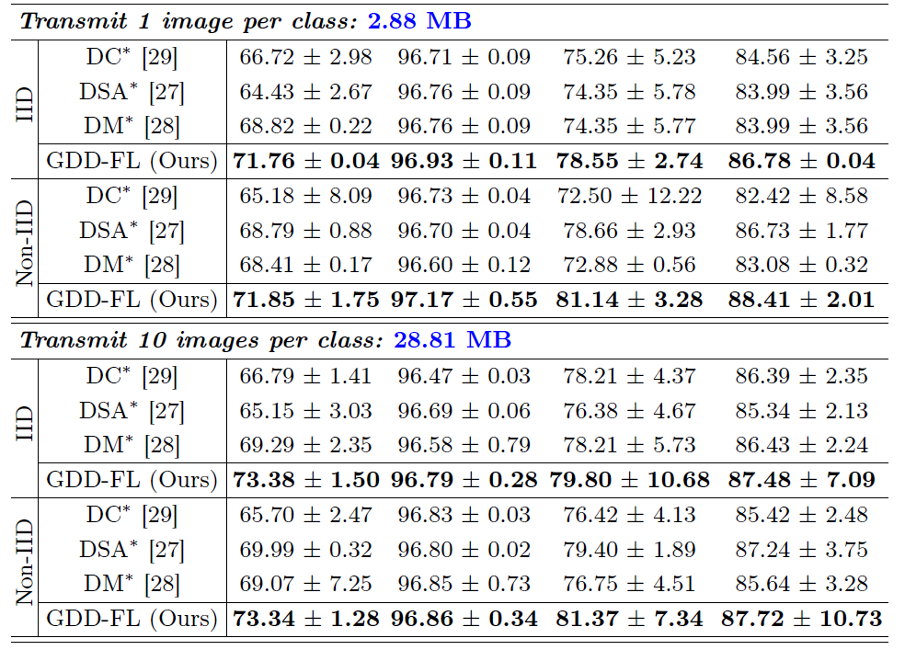
● Experiments
Significantly outperforms other federated dataset distillation methods with the same transmittion and distillation images.
Quantitive results on ISIC-2020 datasets with AUC, F1 score, Precision and Recall metrics

Slide 11
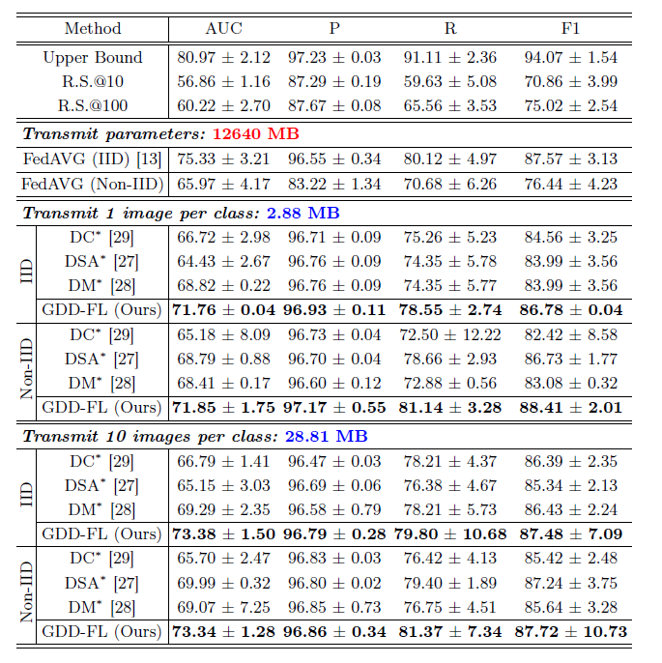
● Experiments
Our method achieves better AUC score compared with model trained by randomly sample the same number of images
Our model has almost the same performance but huge communication cost reduction compared with FedAvg

Slide 12
Conclusion
We introduce a communication-efficient federated skin lesion classification framework using generalizable data distillation
We conduct experiments on ISIC-2020 dataset and demonstrate that our method outperforms other methods of all settings

Slide 13
THANKS FOR LISTENING!

