Slide 1
Global and Local Explanations for Skin Cancer Diagnosis Using Prototypes
C. Santiago, M. Correia, M. R. Verdelho, A. Bissoto, C. Barata
Notes:
Hello everyone. Today, I am here to present "Global and Local Explanations for Skin Cancer Diagnosis using Prototypes." This research was a collaborative effort involving Carlos Santiago, Alceu Bissoto, Rita Verdelho, Catarina Barata, and myself, Miguel Correia.

Slide 2
Motivation
AI assistants would be more effective at communicating decisions if they mimicked a dermatologist’s reasoning
Example-based explainability – find similar cases to justify decision
  Global explanations
    Humans: Expertise gained from previous cases
    AI: Classification based on content-based image retrieval
  Local explanations
    Humans: 7-point checklist / ABCD rule
    AI: Patch-wise classification
Notes:
The motivation behind this work is closely related to our desire to have an AI model capable of providing a decision and an explanation, thereby being an interpretable model rather than a black box. We aim for this model to offer an explanation that aligns with how dermatologists think when making a diagnosis.
In this context, the explanation is achieved through a comparison with similar examples, both on a global and local level. This is because a medical professional can essentially adopt these two approaches: First, they may examine the skin lesion and recognize it as a specific case within a class due to its resemblance to similar past cases. Secondly, they can analyze the image for dermatological characteristics and structures, focusing on localized areas in the image that contribute to the diagnostic conclusion of the lesion.
In other words, this implies that we can have a global explanation aligning with Content-Based Image Retrieval (CBIR) in AI, explaining how the case fits into a broader context of similar cases. Additionally, we can have local explanations aligning with classification, considering patches of the image from an AI perspective. This approach is akin to the criteria of the 7-point checklist or the ABCD rule used by dermatologists.

Slide 3
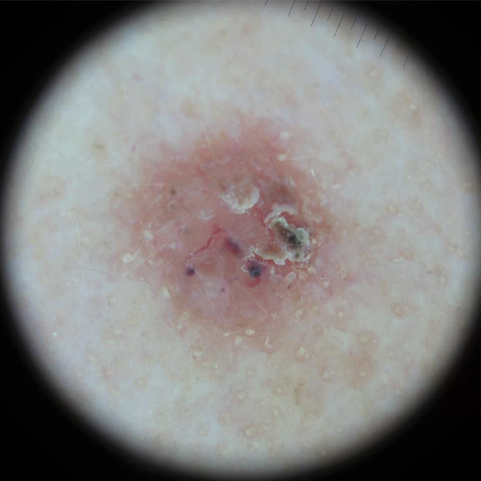
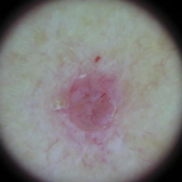
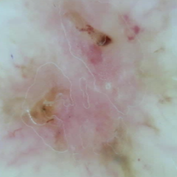
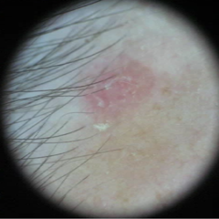
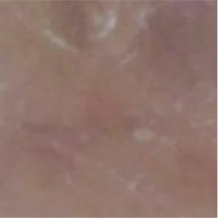
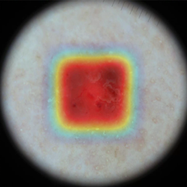
Motivation
  Global explanations
  (similar images)
  Local explanations
  (similar patches)
Notes:
The objective is that given an image, we aim to showcase cases from the same class that are representative of it. We'll refer to these as "global prototypes." Additionally, we aim to present fixed-sized patches from images of the same class as the one we are diagnosing, which are representative of features specific to that class. These will be referred to as "local prototypes."

Slide 4
Our Aim
Develop an AI model that diagnoses skin lesions by
Finding similar images – “This lesion looks like melanomas I have seen before, so it is probably a melanoma”
Finding discriminative regions in the image – “Melanomas typically exhibit these features, so it is probably a melanoma”
Notes:
By utilizing the information provided by both global and local prototypes, we aim to effectively conclude, for instance, that a skin lesion image corresponds to a melanoma case. This conclusion can be drawn based on its similarity to typical cases of melanoma we have observed, as well as specific features within the lesion that are characteristic of the class to which it belongs. For instance, we can determine that an image is indeed a melanoma due to its resemblance to similar observed melanoma cases and the presence of characteristic elements such as an atypical pigment network, reticulation, or a blue-white veil within the lesion.

Slide 5
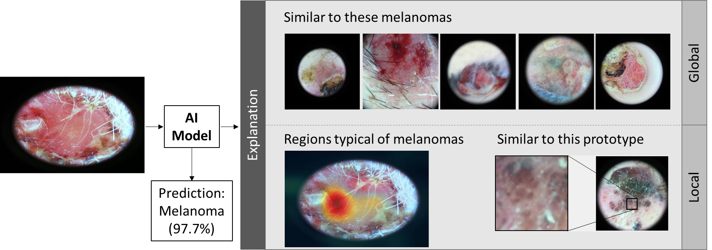
Our Aim
Notes:
In summary, the explanation of the interpretable model we would observe could be outlined as follows: we are able to view the image under diagnosis, along with the probability of it being classified as belonging to a specific class. Additionally, we can observe typical examples of the melanoma class that are similar to this image (global prototypes). Furthermore, we can pinpoint areas of the image, as highlighted by the activation map, that closely resemble typical characteristic parts of this class - the local prototypes.

Slide 6
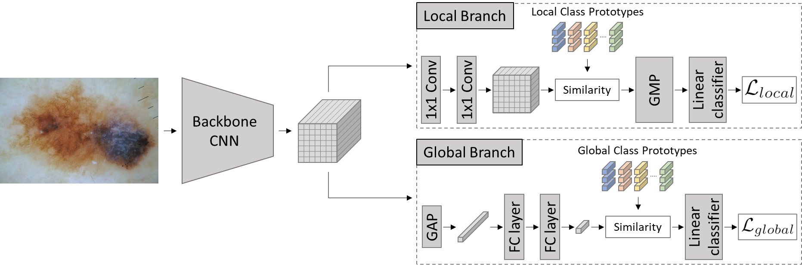
Proposed Model
Notes:
Indeed, in terms of our approach's architecture, we start with an input of a skin lesion image. This image is passed through a CNN backbone, which is shared by both a local branch and a global branch. The backbone is responsible for feature extraction, obtaining a latent representation of the image. Next, within the local branch, we classify the image based on the similarity of its parts, latent representation of images patches, to the local prototypes. Meanwhile, within the global branch, we make a decision by comparing the latent representation of the entire image to the global prototypes.
The final decision of the model takes into account the average decision from both branches, providing a comprehensive and balanced assessment. Note that, $L_{global}$ and $L_{local }$represent the cross-entropy losses for the global and local branches.

Slide 7
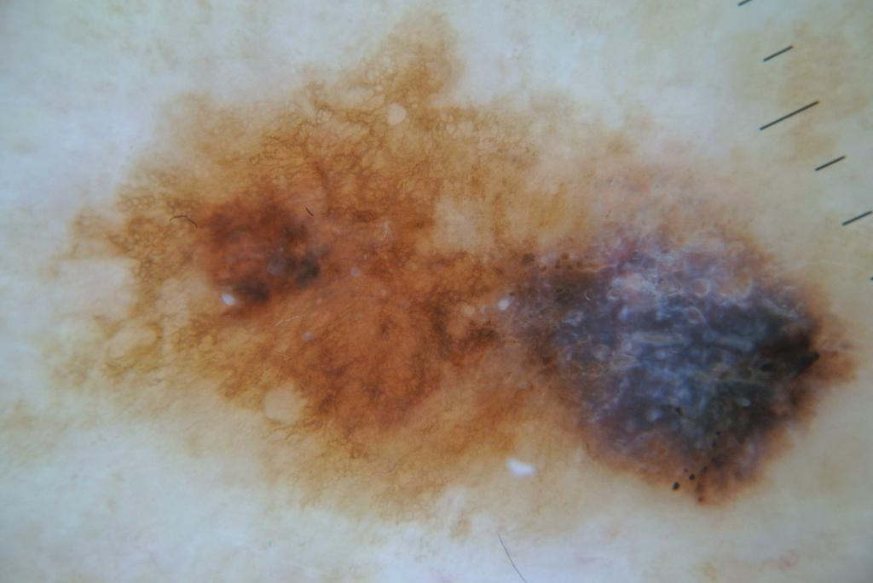
Proposed Model
Classification is based on prototypical networks
  The model learns class prototypes and classifies by measuring the similarity between images/patches and prototypes
Local Class Prototypes
Similarity
Melanoma
Notes:
As you can see, the image can be divided into fixed-sized square patches. The dimensions of these patches correspond to the size of a local prototype, representing a specific local characteristic of skin lesions. Each of these patches will have a latent representation corresponding to a pixel on a 2D map obtained through the convolution layers. For each of these patches, we calculate similarity with each of the local prototypes. The similarity is computed in the latent space using cosine similarity, allowing us to measure how closely the patch aligns with each local prototype.

Slide 8
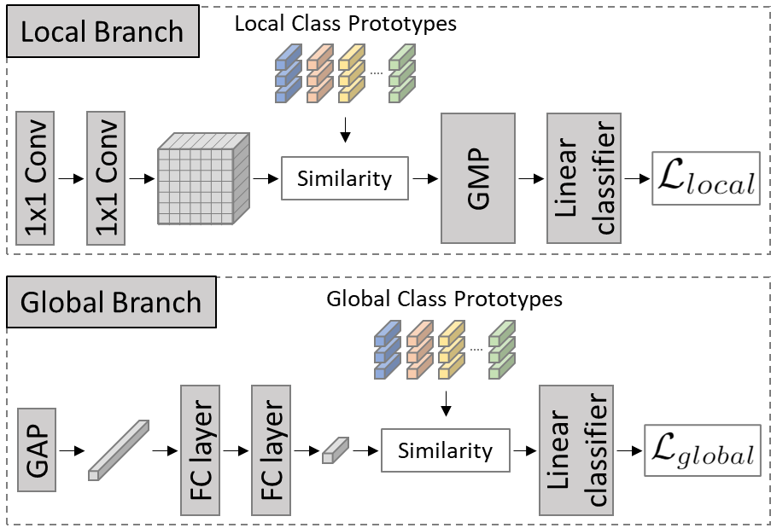
Proposed Model
The model is trained to classify on a global and local level
  Combining global and local losses
Notes:
Continuing to focus on the local prototypes within the local branch, notice how we incorporate two convolution layers after the CNN backbone. These layers serve to reduce the dimension of the latent space. After calculating the similarities between each patch of the image and each local prototype, we end up with a similarity matrix. By applying global max pooling to this matrix, we obtain the similarity between the image and the local prototype. Therefore, it's these similarities between the image and each local prototype that will serve as the input for the classifier.
Shifting our focus to the global branch, notice how the feature maps obtained by the CNN backbone, representing the input image, are combined using global average pooling. This process reduces them to a vector of smaller dimensions by passing through two fully connected layers. This vector represents the overall information of the image in the latent space, which is then used to calculate similarities with the global prototypes using cosine similarity. Similarly, the similarities between the image and each global prototype will serve as input for the classifier.

Slide 9
Proposed Model
We ensure it learns better and more diverse prototypes
  A clustering loss forces the model to simultaneously learn the prototypes while performing K-means on the feature space
Notes:
During training, in addition to considering the cross-entropy losses associated with the global and local branches, we also integrate a cluster loss. This loss functions to guide the learning process of the prototypes, ensuring they accurately represent the class to which they belong. Simultaneously, the mini-batch k-means algorithm is applied to the feature space, enabling the learning of prototypes that act as centroids of the clusters, representing diverse characteristics of the class.

Slide 10
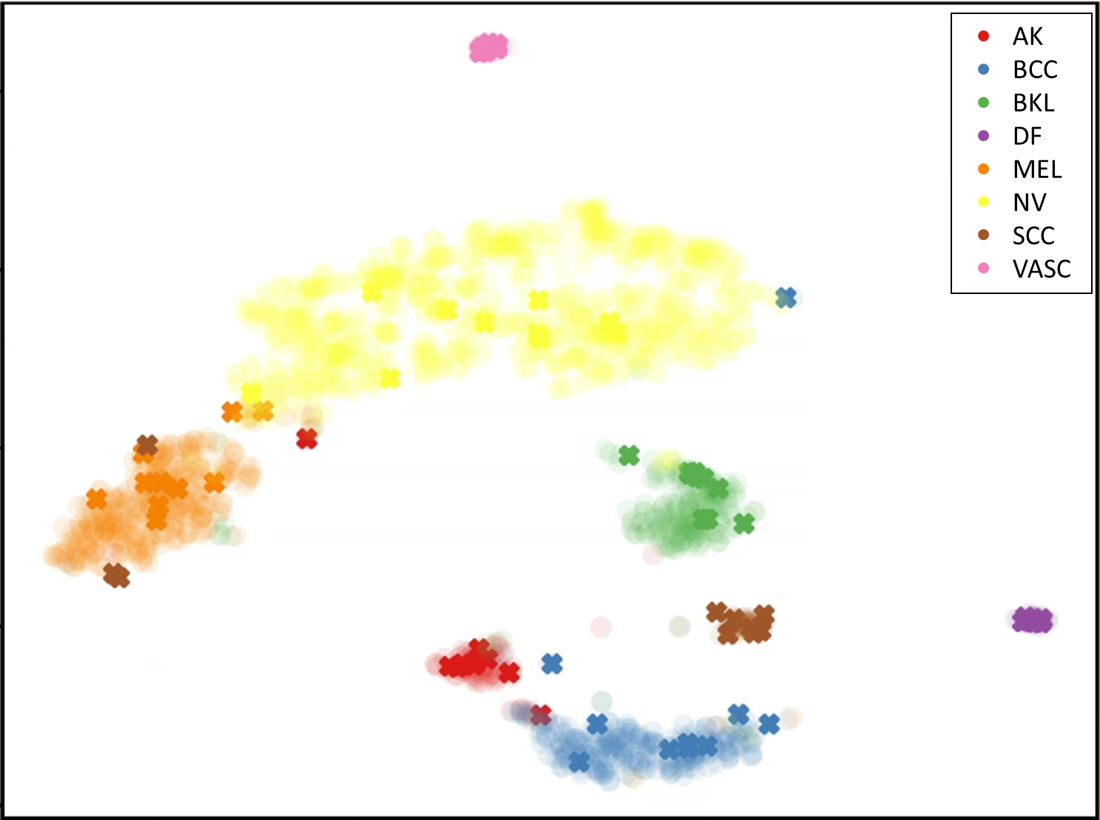
Results
Training data
Learned prototypes
Notes:
Notice in the image how the model facilitates obtaining a latent representation where the examples of each class are well-clustered, with the centroids of these clusters representing the learned prototypes. Each color represents a different class, with the dots representing samples from the training set and the crosses representing the learned prototypes. This visualization demonstrates how the model effectively groups similar examples and learns meaningful prototypes for each class.

Slide 11
Experimental Setup
ISIC 2019 dermoscopy dataset:
  8 classes, 20 prototypes for each (10 local, 10 global)
  80/20 split for training/validation
Evaluation metrics:
  Classification accuracy, Balanced accuracy, F1 score
5 backbone architectures evaluated:
  ResNet18, ResNet50, VGG16, DenseNet169, and EfficientNetB3
Comparison and ablation studies:
  Baseline architecture, Global only, Local only, ProtoPNet, ProtoTree
Notes:
In terms of the organization of the experiments, it's important to note that we utilized the ISIC 2019 dataset, which comprises 8 classes. For each class, we employed 20 prototypes, with 10 being global prototypes and 10 being local prototypes. The dataset was divided into 80% for training and 20% for validation, allowing us to effectively train and evaluate the model using this partition. Furthermore, the metrics considered were accuracy, balanced accuracy, and F1-score. The inclusion of balanced accuracy and F1-score is crucial given the dataset's inherent imbalance, ensuring a comprehensive evaluation that accounts for the varying class distribution. These metrics collectively provide a robust assessment of the model's performance in handling the imbalanced nature of the dataset. We employed 5 different CNN architectures and compared the proposed approach with cases where we exclusively utilized either the local or global branch independently. Additionally, we compared against a representative model that functions as a black box, providing no explanations. Furthermore, we compared with other interpretable models like ProtoPNet and ProtoTree, which also offer explanations at the prototype level. This comprehensive comparison allowed us to evaluate the effectiveness and interpretability of our approach relative to various baseline and interpretable models.

Slide 12
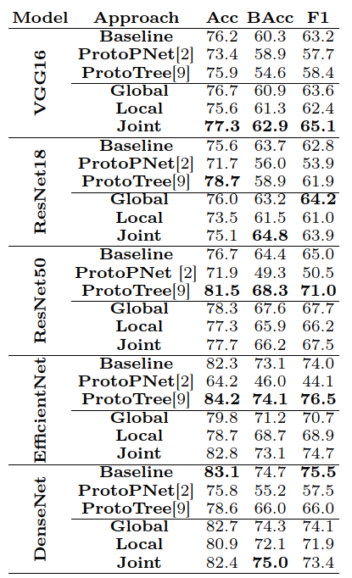
Results
Notes:
Global Prototypes vs Baseline: Outperforming the baseline into three out of the five architectures. This demonstrates that making a decision based on comparing the image under diagnosis with similar and representative images of the class to which it belongs, not only provides an easily understandable explanation but also contributes to improved performance levels. Leveraging this approach enhances both interpretability and effectiveness in the diagnostic process.
Local Prototypes vs ProtoPNet/ProtoTree: Indeed, ProtoPNet demonstrates lower performance compared to the other scenarios, with ProtoTree performing better than ProtoPNet and proving to be the best scenario with ResNet-50 and EfficientNet. However, it's crucial to note that ProtoTree's performance is highly sensitive to the CNN backbone used. Local prototypes showcase better performance than ProtoPNet, and observing the Balanced Accuracy values, we can see how our local branch, even when considered individually, handles the dataset's imbalance better in 3 out of the 5 architectures. This underscores the effectiveness of our proposed approach, particularly the local branch, in dealing with the dataset's inherent imbalanced nature.
Joint vs Single Models: Upon assessing the distinct branches, it becomes evident that the global prototypes consistently surpass the local counterparts. This outcome is somewhat anticipated, given that relying solely on a local analysis may cause us to overlook pertinent contextual cues regarding the lesions. Upon integrating the two branches, we consistently notice an enhancement in performance, implying that each branch holds significant and mutually beneficial information.

Slide 13
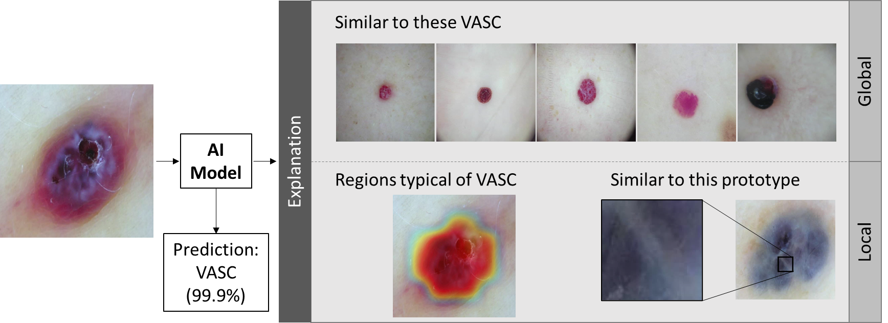
Results
Notes:
In this image, we can observe the probability of this image being a vascular lesion, as well as typical cases of this class corresponding to the global prototypes. Additionally, we can see that the region corresponding to the interior of the lesion bears a striking resemblance to the local prototype, representing bluer areas typical of vascular lesions. Note in the red area presented in the activation map.

Slide 14
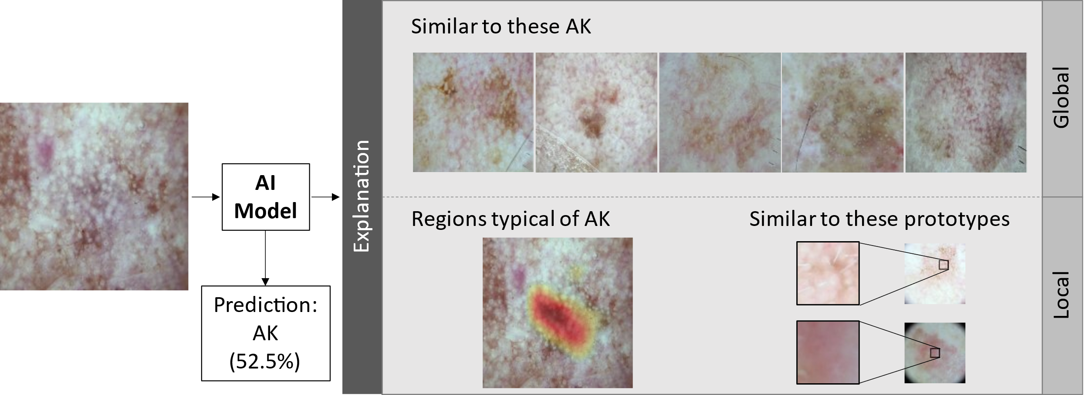
Results
Notes:
In this case, we have an example of an image of Actinic Keratosis correctly classified with a probability of 52.5%. Once again, notice the high similarity with lesions of the same class. The central region of the image exhibits a strong resemblance to structures associated with white spots and pinkish tones characteristic of this class.

Slide 15
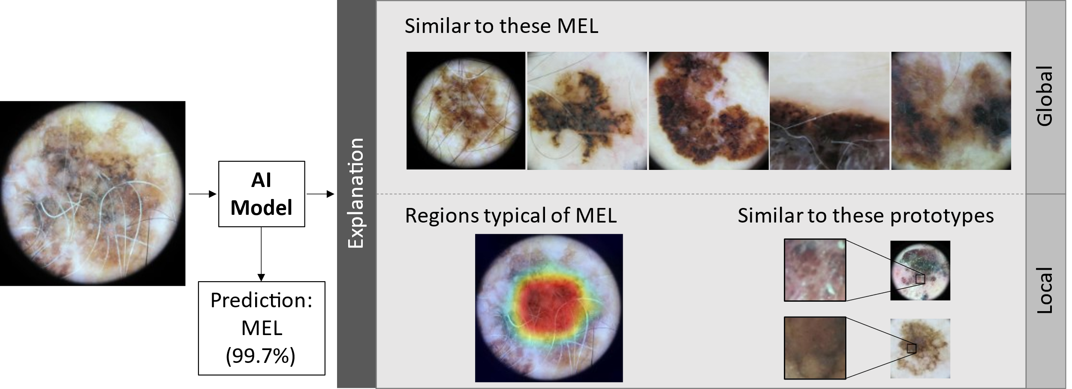
Results
Notes:
Finally, here we can see an example of melanoma and how similar it is to the global prototypes, displaying these prominent brown tones and a strong resemblance to local features in the image that are representative of this class.

Slide 16
Conclusions
We proposed a new approach for skin cancer diagnosis that simultaneously provides global and local explanations to support the decision
It integrates two interpretable classifiers based on global and local prototypes
Our results are competitive/outperform blackbox models and similar approaches
Future work: integrate human feedback during training for better prototypes
Notes:
In conclusion, this research introduces an innovative methodology for skin cancer diagnosis, offering both global and local explanations to aid in informed decision-making. Our devised model seamlessly combines two interpretable classifiers, leveraging global and local prototypes. Through extensive experimental evaluations employing diverse CNN backbones, our approach has exhibited promising potential, paving the way for a new paradigm in Explainable Artificial Intelligence (XAI) within the domain of medical image analysis, since it was able to outperform non interpretable model and already known interpretable architectures.
Looking ahead, our future research endeavors involve enhancing the training of local prototypes by incorporating a limited set of annotations. Furthermore, we aim to integrate this model into a user-centric experiment to evaluate the clinical significance of the prototypes and further integrate medical expertise into the system, thereby advancing the applicability and impact of our approach in real-world medical practice.

Slide 17
Thank you
Feel free to send questions to carlos.santiago@tecnico.ulisboa.pt.

