Slide 1






AViT: Adapting Vision Transformers for Small Skin Lesion Segmentation Datasets
Siyi Du¹
Nourhan Bayasi¹
Ghassan Hamarneh²
Rafeef Garbi¹
Eighth ISIC Skin Image Analysis Workshop @ MICCAI 2023
October 12, 2023
1
2
Notes:
Hi everyone, my name is Siyi Du. I’m very honored to be here and introduce our work: AViT: Adapting Vision Transformers for Small Skin Lesion Segmentation Datasets. This work is completed by UBC and SFU.

Slide 2
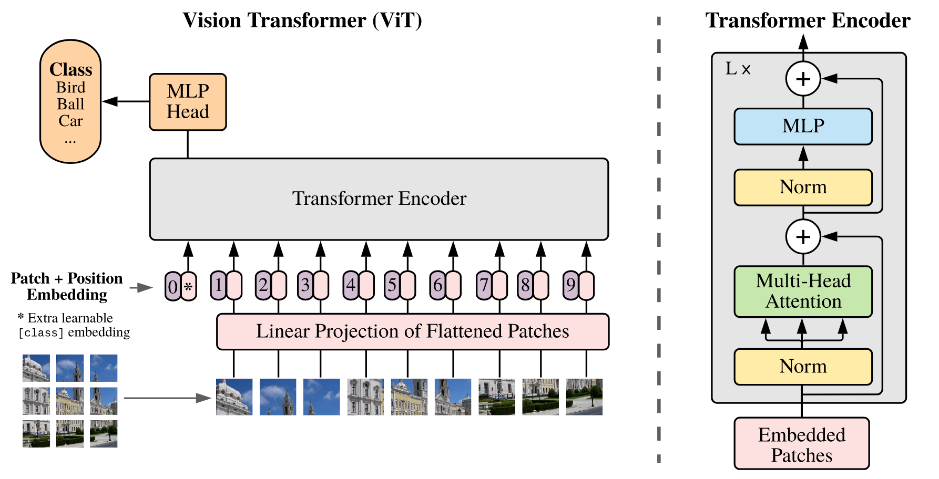
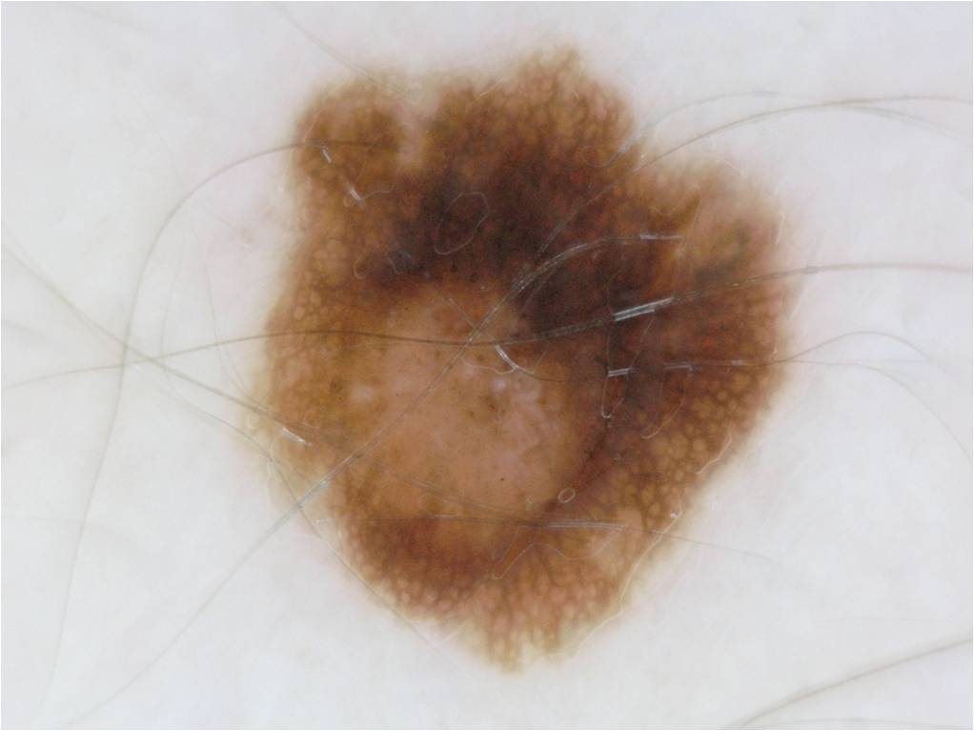

1.1 Skin Lesion Segmentation
Skin Lesion segmentation (SLS) is a crucial component in skin lesion analysis.
Vision transformers (ViTs) have been considered a promising technique to tackle SLS.
DNN Model
Skin Lesion Segmentation (SLS)
Vision Transformer (ViT)^{[1]}
[1] Dosovitskiy, Alexey, Lucas Beyer, et al. , Thomas Unterthiner, Mostafa Dehghani, et al. “An Image Is Worth 16x16 Words: Transformers for Image Recognition at Scale,” 2020.
Notes:
Skin lesion segmentation is a crucial component in skin lesion analysis. It can serve as a pre-processing step or simultaneously optimizing task for classification to boost its accuracy and robustness.
(click) New vision transformer architecture is a promising way to tackle skin lesion segmentation. Compared to convolutional neural networks, it utilizes self-attention to more effectively and efficiently capture global information.

Slide 3
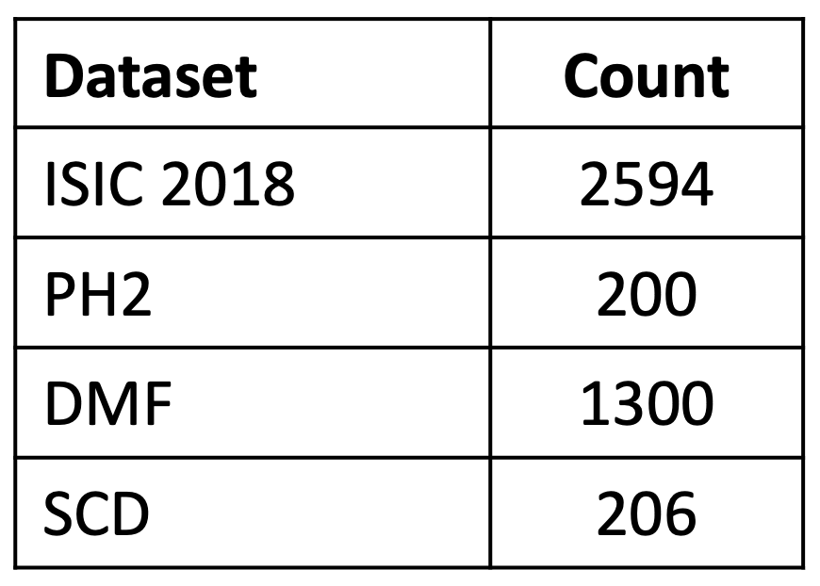
1.1 Skin Lesion Segmentation
ViTs need more training data than CNNs due to the lack of some inductive biases.
However, we can only access to multiple, diverse, yet small-sized datasets for the same SLS task.
Public SLS datasets
Notes:
However, ViTs need more training data than CNNs due to the lack of some inductive biases such as weight sharing and locality.
This poses a problem in the skin lesion segmentation task,
(click) Because typically we can only access to multiple, diverse, yet small-sized skin lesion segmentation datasets. For example, ISIC 2018 has 2 thousand samples and PH2 has 200 samples

Slide 4
1.2 Current Practices and Challenges
Various strategies were proposed to tackle ViTs’ data-hunger in SLS.
However, they rely on full fine-tuning and pose two problems
  High computational and memory costs
  May destroy the model’s generalizable representations.
ViT-Base 86M, Swin-Base 88M
VITs’ data-hunger mitigation in SLS
Adding inductive bias
CNNs' inductive bias
Transferring knowledge
Pre-train + fine-tune
Multi-level structure, etc.
Dataset 1
Model 1
Dataset 2
Model 2
Dataset 3
Model 3
Dataset 4
Model 4
One whole model x 4
Notes:
To address ViTs’ data hunger, various strategies were proposed and can be categorized into two directions: adding inductive bias and transferring knowledge
(click) The first direction can add some CNNs’ inductive biases, or multi-level structure assumption through hierarchical architecture.
(click) As transfer learning from ImageNet has shown beneficial to skin lesion tasks, a more popular way is to deploy a pre-trained VIT backbone as the encoder, aiming to use the knowledge learned from a larger set of natural images to reduce the skin training data needed.
(click) But these approaches rely on full-finetuning and pose two major problems.
(click) First, ViT backbones typically have millions of parameters, thus making full-finetuning quite expensive in computation and memory cost, especially when dealing with multiple datasets.
(click) For example, if we want to deal with four datasets, we need to train and store one entire model for each dataset.
(click) Second, updating all the parameters of a large pre-trained model on smaller datasets is found to be unstable and may instead destroy the model’s generalizable representations.

Slide 5
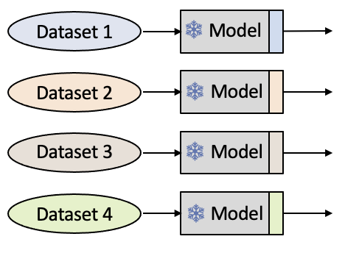


1.2 Current Practices and Challenges
Parameter-efficient Fine-tuning (PEFT) only tunes a small subset of the model’s parameters
  Adapter tuning: inserts trainable lightweight adapter modules
  Prompt tuning: adds soft prompts to the input space
However, few works have adapted PEFT to medical imaging
We introduce AViT, a novel PEFT strategy that adapts any pretrained ViT to the SLS task
Increased efficiency Comparable/improved performance
Model
Trainable
Adapter
Frozen
Adapter
Model
...
Adapter
Input
Prompt
Input
Parameter-efficient Fine-tuning
Adapter Tuning
Prompt Tuning
Notes:
To address the limitations of full finetuning, one promising solution is parameter-efficient fine-tuning.
(click) It only tunes a small subset of the model’s parameters. Current PEFT methods can be categorized into two groups.
(click) Adapter tuning algorithms insert trainable lightweight adapters to modify the hidden representation of a frozen VIT.
(click) Prompt tuning approaches add soft prompts, which are free trainable parameters, to a ViT’s input space.
(click) These PEFT methods have shown substantially increased efficiency with comparable, or even improved, performance compared to those of full fine-tuning on low-data regime.
(click) However, few works adapted PEFT to medical imaging
(click) Thus, we introduce AViT, a novel PEFT strategy to efficiently mitigate data-hunger by adapting any pretrained VIT to the skin lesion segmentation task.

Slide 6
1.3 Contributions
Introduce PEFT to alleviate ViTs' data-hunger in medical image segmentation.
Integrate a prompt generator to enhance representation learning.
AViT: Adapting Vision Transformers
Propose AViT, with adapters to transfer a pre-trained ViT to the SLS task.
AViT highly improves parameter-efficiency and achieves competitive segmentation results.
Notes:
Therefore, in this work
(click) We are the first to introduce parameter-efficient fine-tuning to directly mitigate ViTs' data-hunger in medical image segmentation.
(click) Second, we propose AViT, with adapters to transfer a pre-trained ViT to the SLS task.
(click) and integrate a prompt generator to enhance representation learning
(click) The experiments show that AViT highly improves parameter-efficiency and achieves competitive segmentation results.
9

Slide 7
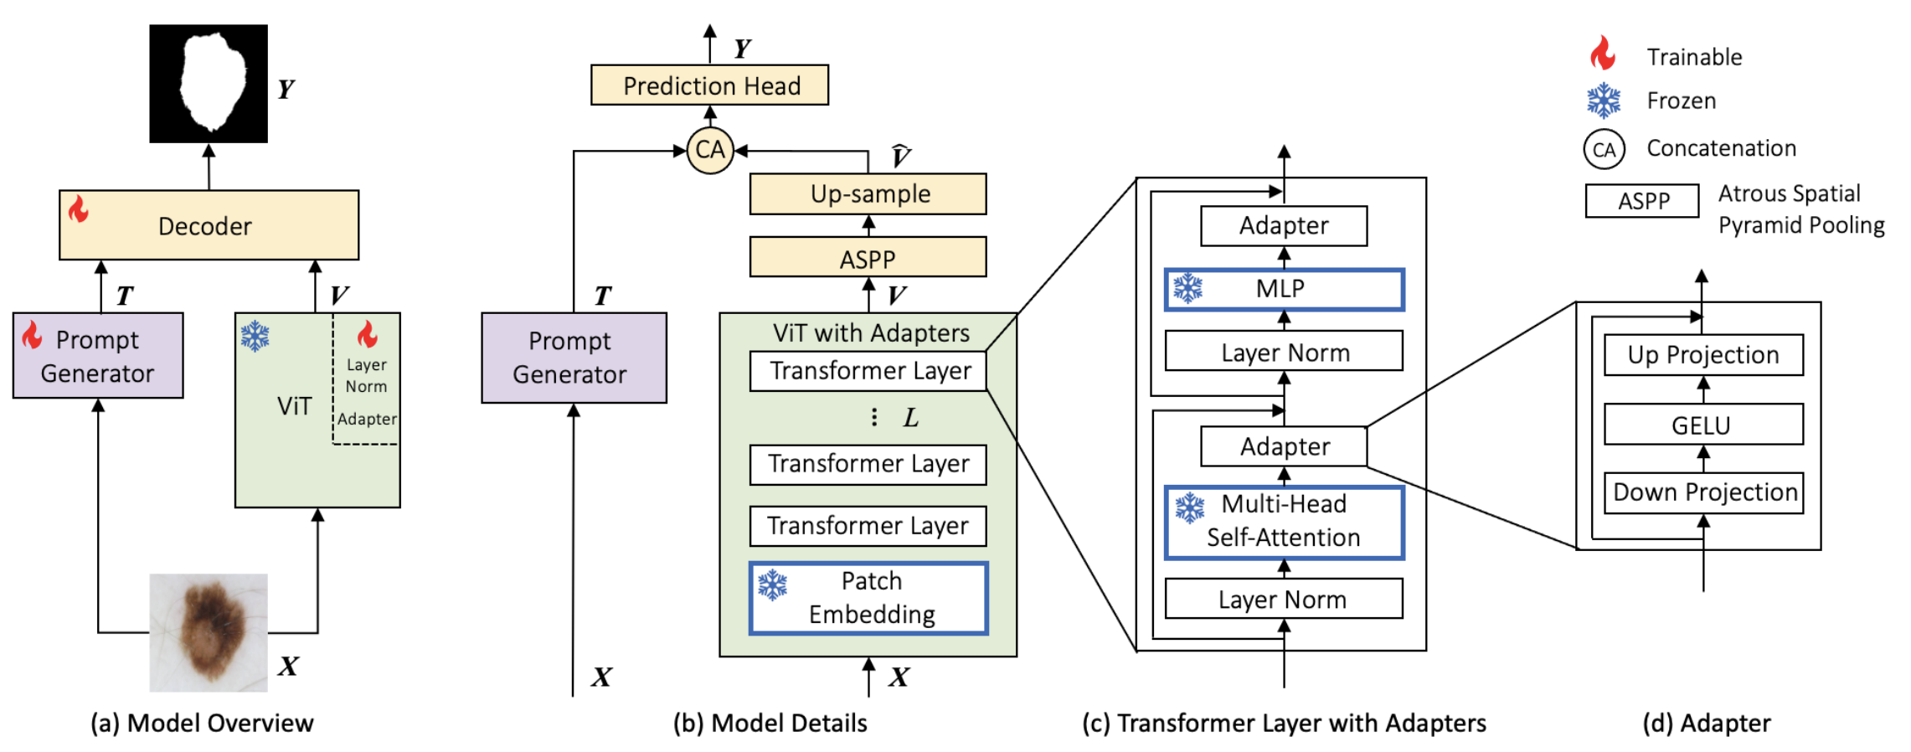

2.4 AViT
Apply a pre-trained VIT backbone to the downstream SLS task and only optimize few parameters (13.7%).
Adapter Tuning: adjust the generated feature representation adapted to skin images while leaving the weights of the backbone fixed
Prompt Tuning: produce a prompt embedding to enhance the representation learning
Lightweight Decoder: predict a segmentation map
Notes:
This is our model architecture
(click) AViT applies a pre-trained VIT backbone to the downstream skin lesion segmentation task and only optimizes 13.7% parameters.
To achieve that,
(click) First, we insert adapters into a frozen ViT to adjust the feature representation V adaptive to skin images
(click) Second, we utilize a prompt generator to produce a prompt embedding T for representation learning enhancement.
(click) Finally, a lightweight decoder is used to combine T and V to predict a segmentation map.
Next, I am going to introduce the details of the proposed mechanisms.

Slide 8
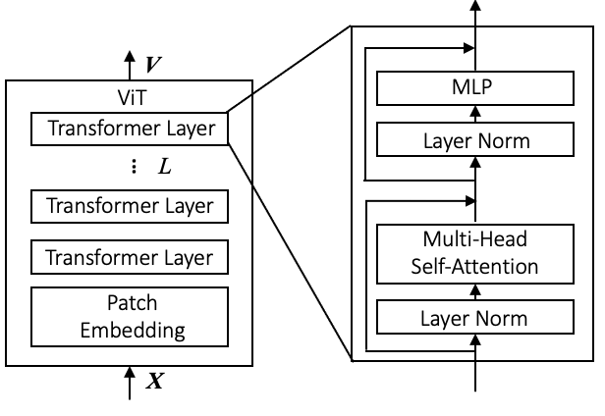
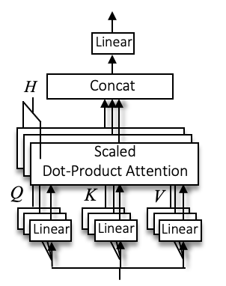


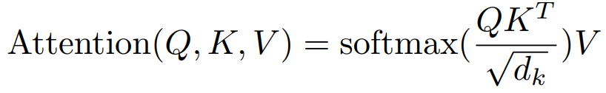
2.3 Basic ViT
ViT
Transformer Layer
Multi-head Self-attention (MHSA)
Patch embedding: converts a feature map into a sequence of patch embeddings
Transformer layer
  Multi-head self-attention module (MHSA)
  MLP
Notes:
A basic ViT contains
(click) a patch embedding module
(click) and L transformer layers.
(click) The Patch embedding module converts an image feature map X into a sequence of patch embeddings z. P is the patch size
(click) Each transformer layer includes two key modules.
(click) The multi-head self-attention module let the model to jointly attend to information from different feature spaces at different image patches.
(click) The attention equation first calculates the dot product of the query with all keys, and apply a softmax function to obtain the weights on the value.

Slide 9
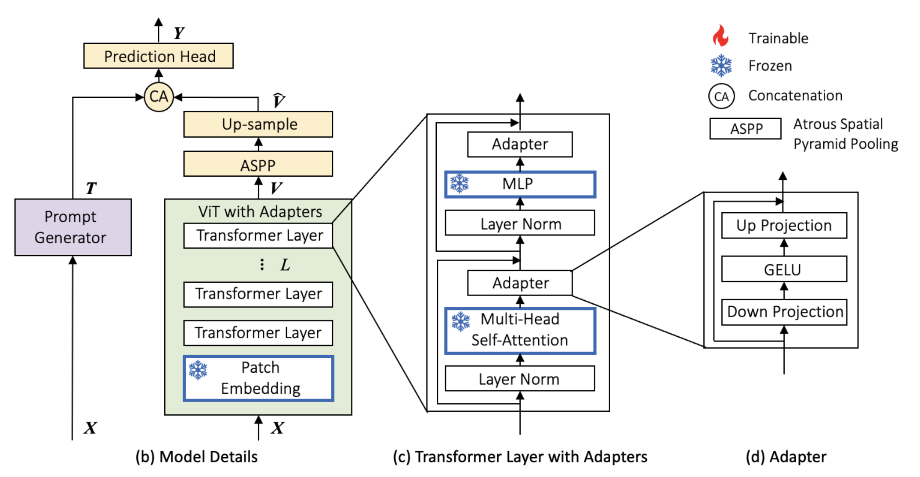
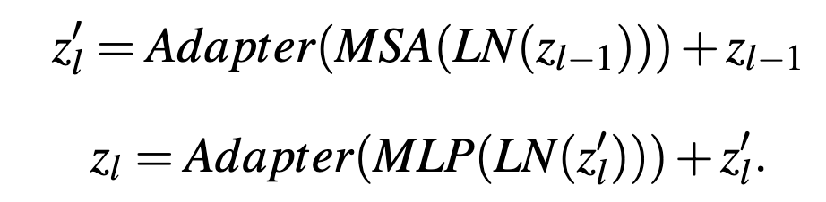
2.4 AViT
Adapter Tuning
Notes:
In AViT,
(click) We insert the adapter after multi-head self-attention and MLP of each transformer layer.
(click) The adapter contains two linear layers and a GELU function.
During training, we only optimize adapters and layer norm in the VIT.

Slide 10
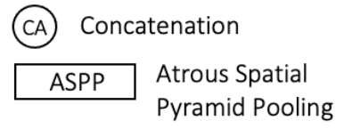
2.4 AViT
Prompt Tuning
The prompt is hypothesized to grasp CNNs’ helpful inductive biases and fine-grained information.
Lightweight Decoder
Atrous spatial pyramid pooling
7 convolutional layers
Notes:
For prompt tuning,
(click) we utilize a shallow CNN to create a prompt embedding from the input image, which is hypothesized to grasp CNNs’ helpful inductive biases and fine-grained information.
(click) After that, we incorporate a compact decoder for efficient prediction. This choice is driven by the powerful and over-parameterized nature of large pre-trained VIT backbones.
(click) It contains an atrous spatial pyramid pooling module, which uses parallel convolutional layers with different dilation rates. Thus it can capture lesion context at different scales.

Slide 11
3.1 Datasets and Metrics
Datasets
  ISIC 2018 2594 samples
  Dermofit Image Library (DMF) 1212 samples
  Skin Cancer Detection (SCD) 206 samples
  PH2 200 samples
Evaluation
  Segmentation performance: Dice and IOU
  Computational cost: gigaFLOPs (GFLOPs)
  Memory footprint: number of parameters
Notes:
In the experiments, we study 4 skin datasets collected from varied sources
(click) ISIC 2018
(click) DMF
(click) SCD
(click) and PH2
For evaluation, we implement 5-fold cross validation and utilize
(click) Dice and IOU metrics for segmentation performance,
(click) GFLOPS for computational cost at inference,
(click) and the number of parameters for memory footprints.
GFLOPs floating point operations per second

Slide 12
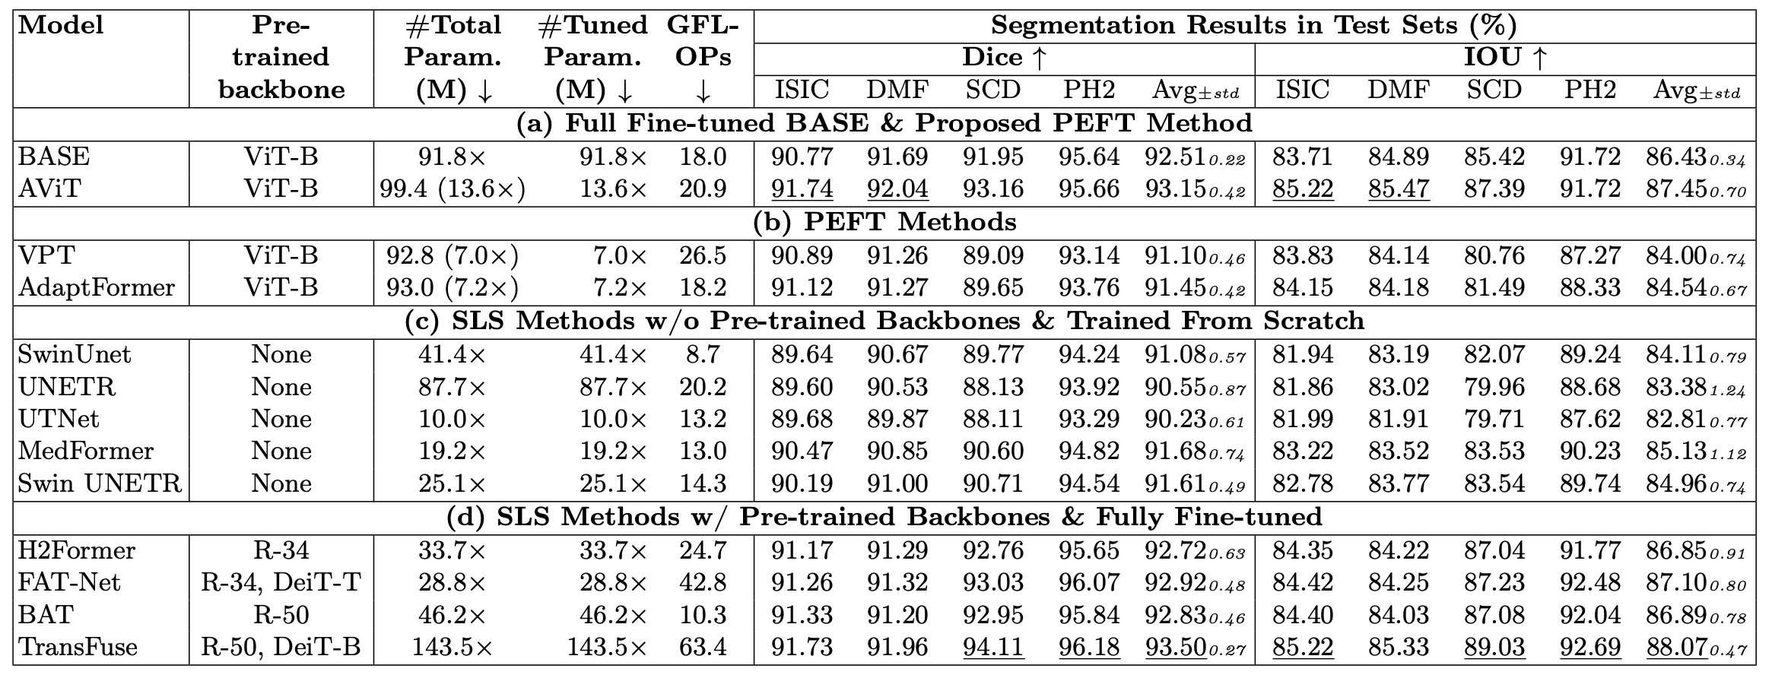
3.2 Main Results
Notes:
We compared AViT with
(click) the baseline,
(click) and other SOTA methods.

Slide 13
3.2 Main Results
Compared with BASE
Compared to BASE, AViT
increase average Dice by 0.64% and IOU by 1.02%
have fewer trainable (54.4M vs 367.2M) and total parameters (140.2M vs 367.2M) for 4 datasets
Notes:
The baseline is built by removing the adapters and the prompt generator of AViT and optimizing all the parameters during training.
(click) From the table, we can find AViT outperforms BASE with better segmentation performance
This suggests that BASE is overfitting, and full finetuning is unsuitable for transferring knowledge to smaller skin datasets. On the other hand, AViT effectively leverages the learnt knowledge and demonstrates strong generalization capability on the SLS task
(click) Moreover, AViT has significantly fewer trainable and total parameters for four datasets. For example, AViT only has around 15% number of parameters of BASE

Slide 14
3.2 Main Results
Compared with SOTAs
1.54%
2.49%
Notes:
Moreover,
(click) AViT also surpasses other parameter-efficient fine-tuning algorithms with comparable parameters
(click) Compared with models without pre-trained backbones and trained from scratch, AViT outperforms them across all datasets by a large margin.
(click) Compared to models with pre-trained backbones and fully finetuned. AViT achieves competitive or higher segmentation performance, with fewer trainable and total parameters.

Slide 15
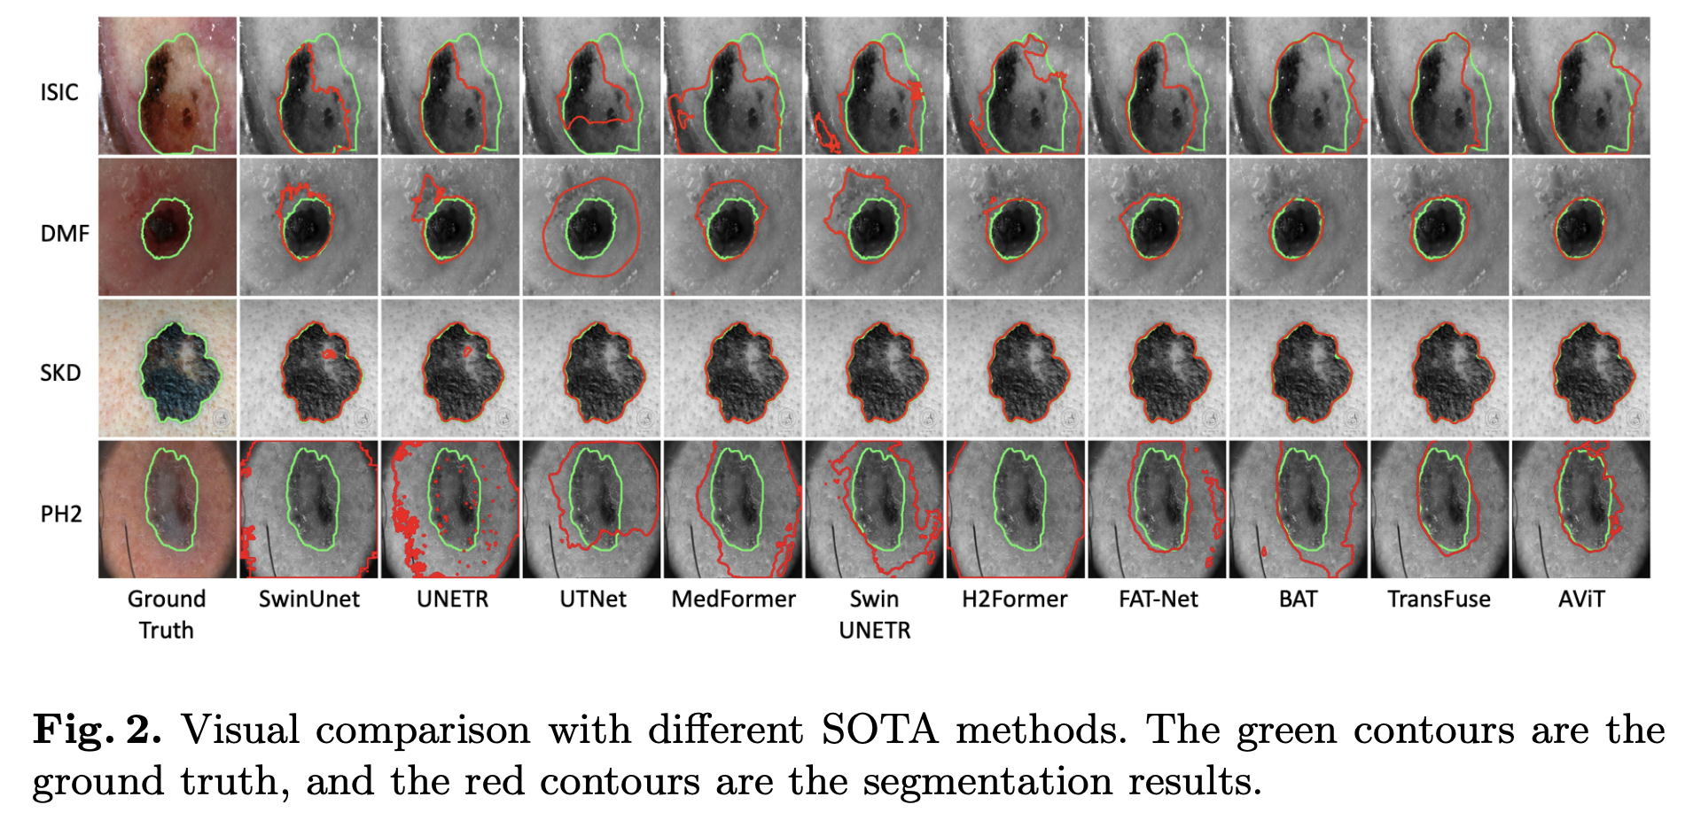
3.3 Visualization
Notes:
The visual result also shows AViT’s excellent performance

Slide 16
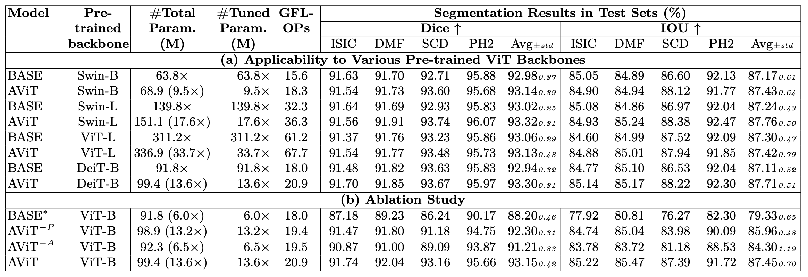
3.4 Applicability and Ablation Study
AViT on different ViT backbones
Ablation Study
BASE*: freeze the parameters of BASE’s ViT
Notes:
After that, we conduct experiments using ViTs in varied structures or training strategies. including Swin transformer, ViT, and DeiT
(click) The table shows that, for each ViT backbone, AViT achieves competitive and even higher performance compared to fully finetuned BASE, but with substantially fewer parameters. This indicates that our method can be applied to different ViTs.
In the ablation study,
(click) we freeze the parameters of BASE’s ViT backbone to get BASE superscript star.
(click) Then we remove the adapters and prompt generator of AViT to get AViT superscript –P and AViT superscript –A.
(click) The table shows that also our proposed two mechanisms boost the segmentation performance, and a combination of both is the best.

Slide 17
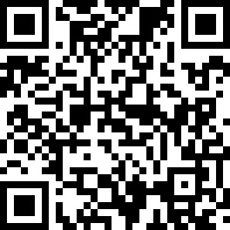
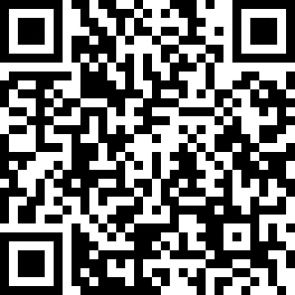
AViT: Adapting Vision Transformers for Small Skin Lesion Segmentation Datasets
Paper is available at
Code is available at
Thank you!
Contact us: {siyi, nourhanb, rafeef}@ece.ubc.ca, hamarneh@sfu.ca
Notes:
That's all. Thank you for your listening.

