Slide 1
FairDisCo: Fairer AI in Dermatology via Disentanglement Contrastive Learning
Siyi Du¹
Ben Hers¹
Nourhan Bayasi¹
Ghassan Hamarneh²
Rafeef Garbi¹
Seventh ISIC Skin Image Analysis Workshop @ ECCV 2022
October 23, 2022
1
2
Notes:
Hi everyone, my name is Siyi Du. I’m very honored to be here and introduce our work: FairDisCo: Fairer AI in Dermatology via Disentanglement Contrastive Learning. This work is completed by the university of British Columbia and Simon Fraser University.

Slide 2
Content
1
Introduction
2
Methodology
3
Experiments
4
Conclusion
Notes:
In this presentation,
(click) I’ll first introduce the background and motivation of our paper.
(click) And then, I’ll talk about the method part, including our FairDisCo model and three widely used fairness algorithms.
(click) After that, I’ll show our experiment results and analysis.
(click) Finally, I’ll talk about the conclusion of this work.

Slide 3
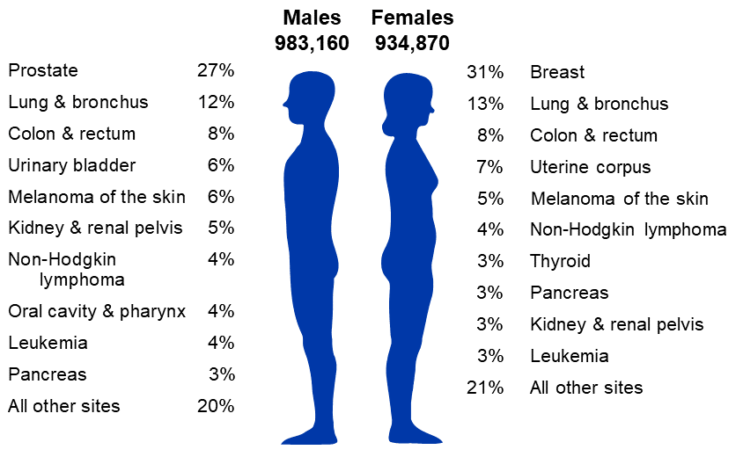
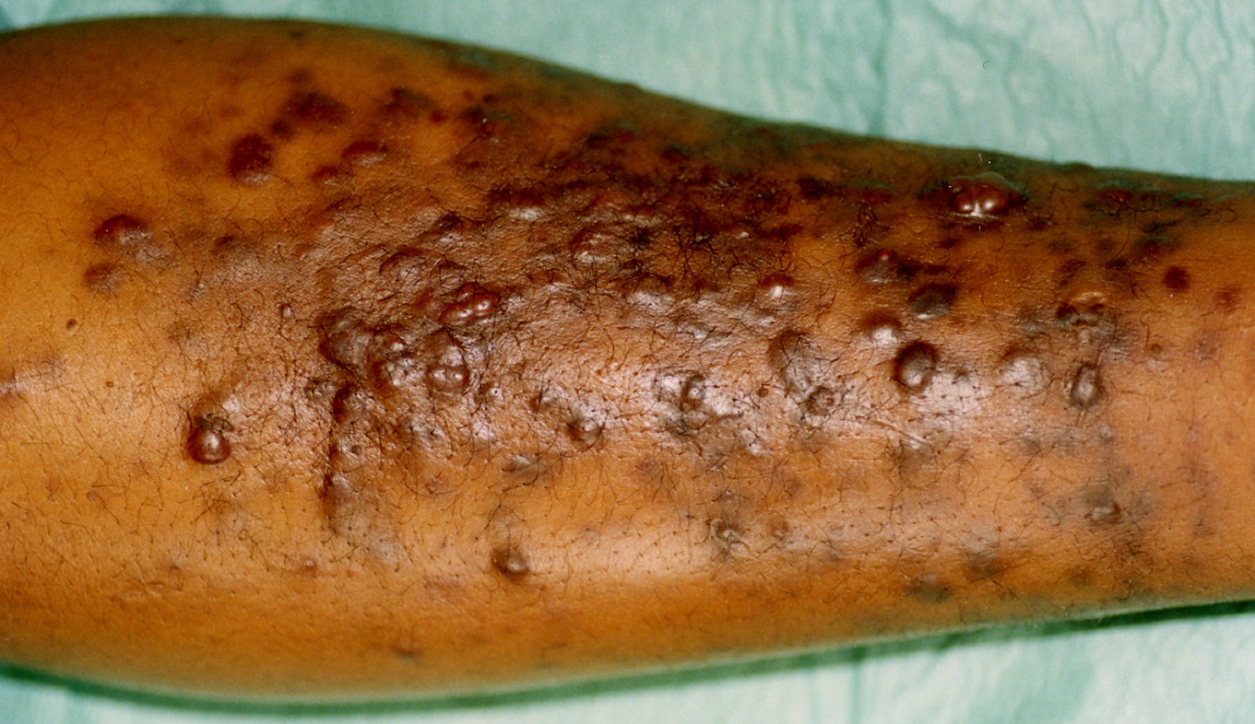
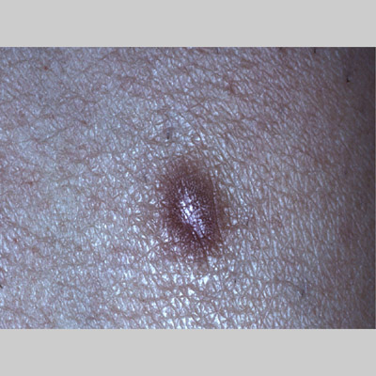
1.1 Skin Lesion Diagnosis
Cancer is one of the leading causes of death worldwide, and the skin is among the 6 most common organs invaded by cancer.
The survival rate of patients could considerably increase by early detection and treatment.
Deep neural networks (DNNs) were introduced to automatically identify possibly cancerous lesions.
DNN Model
Malignant
DNN Model
Benign
New cancer cases in the US in 2022 ^{[1]}
[1] Cancer Facts & Figures 2022 (https://www.cancer.org/research/cancer-facts-statistics/all-cancer-facts-figures/cancer-facts-figures-2022.html#:~:text=Estimated%20numbers%20of%20new%20cancer,incidence%2C%20mortality%2C%20and%20survival%20statistics)
Notes:
(click) Cancer is one of the leading cause of death worldwide, and the skin is among the 6 most common organs invaded by cancer.
(click) However, early detection and treatment could considerably increase the survival rate of patients.
(click) Deep neural networks (DNNs) were introduced to automatically identify possibly cancerous lesions.
They free dermatologists from tedious examination procedures and show a decent diagnosis accuracy.

Slide 4
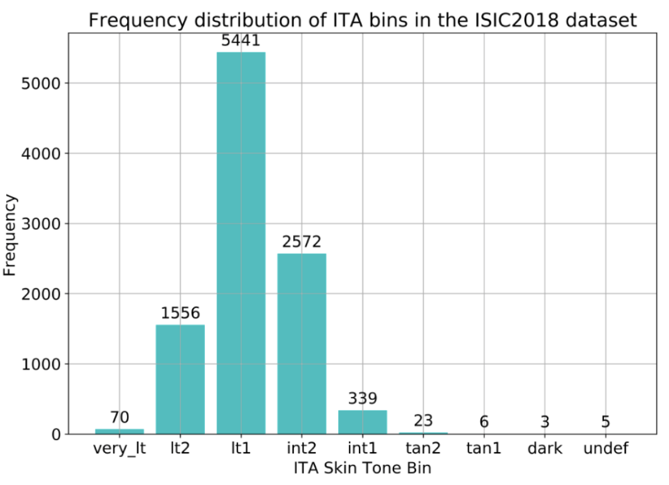
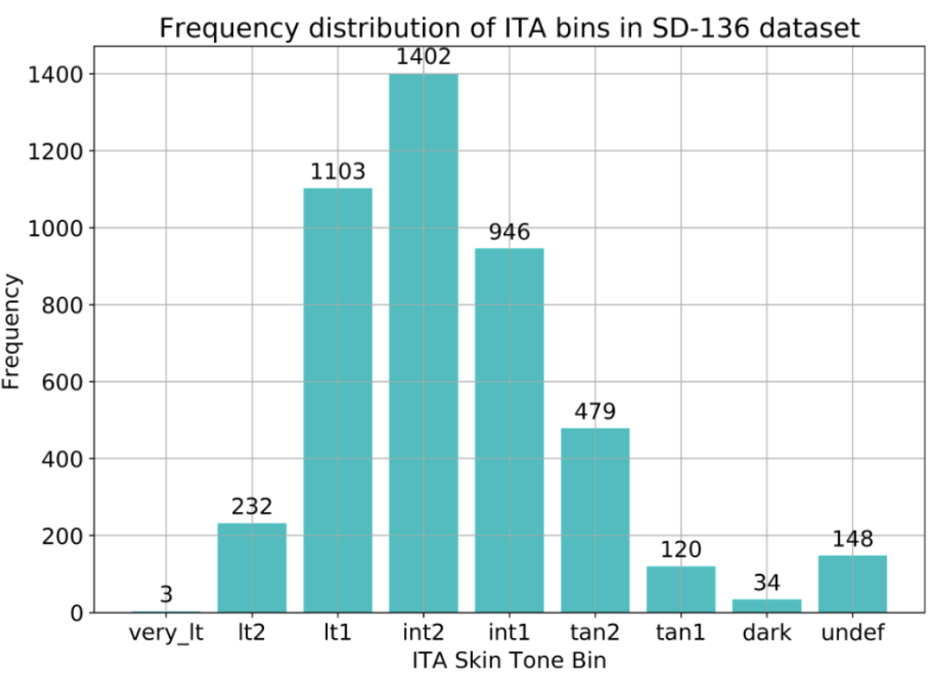
1.2 Skin Type Unfairness
DNNs are vulnerable to biases that render their decisions ‘unfair’, such as skin color.
Patients with darker skin experience a significant drop-off in diagnosis accuracy compared to those of light skin types ^{[2]}.
Few works tried to mitigate skin type unfairness in skin lesion classification task.
The lack of skin images in various skin types
The lack of skin type annotations
Very dark
Very light
Very dark
Very light
[2] Daneshjou et al.: Disparities in dermatology ai: Assessments using diverse clinical images. arXiv preprint arXiv:2111.08006 (2021)
[3] Kinyanjui et al. "Fairness of classifiers across skin tones in dermatology.” MICCAI, 2020.
Notes:
(click) Despite their success, DNNs are vulnerable to biases that render their decisions ‘unfair’, such as skin color.
(click) For example, a recent study has shown that patients with darker skin experience a significant drop-off in diagnosis accuracy compared to those of light skin types. This limits the successful clinical deployment of these models.
(click) Up to now, few works tried to mitigate skin type unfairness in skin lesion classification task
(click）given the following two reasons.
(click) First, most common skin lesion datasets like ISIC or SD-136 lack skin images in very light and very dark colors
Besides, they usually don’t have skin color annotations.
Luckily, the introduction of some new datasets brings promise in this field.

Slide 5
1.3 Motivation
Recent proposing skin lesion datasets with varied skin types and manually annotations make it possible to research skin type unfairness and fairness methods.
Few works paid attention on the skin-type fairness issue, and most of them simplified the experimental setting.
[6] Bevan et al. "Detecting Melanoma Fairly: Skin Tone Detection and Debiasing for Skin Lesion Classification." arXiv preprint arXiv:2202.02832 (2022).
[7] Wu et al. "FairPrune: Achieving Fairness Through Pruning for Dermatological Disease Diagnosis." arXiv preprint arXiv:2203.02110 (2022).
Notes:
Our work is motivated by several reasons.
(click) Recent proposing skin datasets with various skin types and manually annotations make it possible for us to research skin type unfairness and fairness methods.
(click) Few works paid attention on the skin-type fairness issue, and most of them simplified the experimental setting by only testing their models’ generalizability on some skin types or coarsely grouping 6-scale skin types into light and dark.

Slide 6
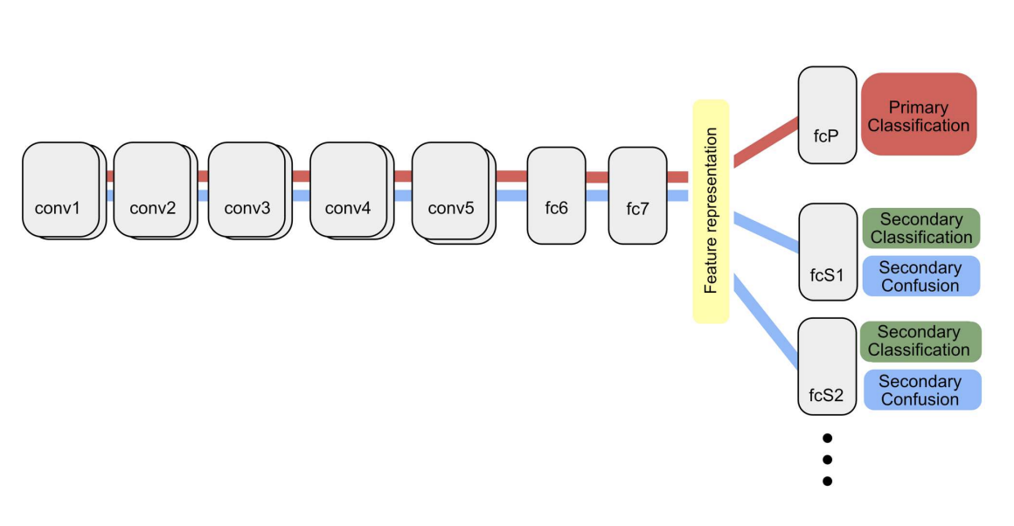
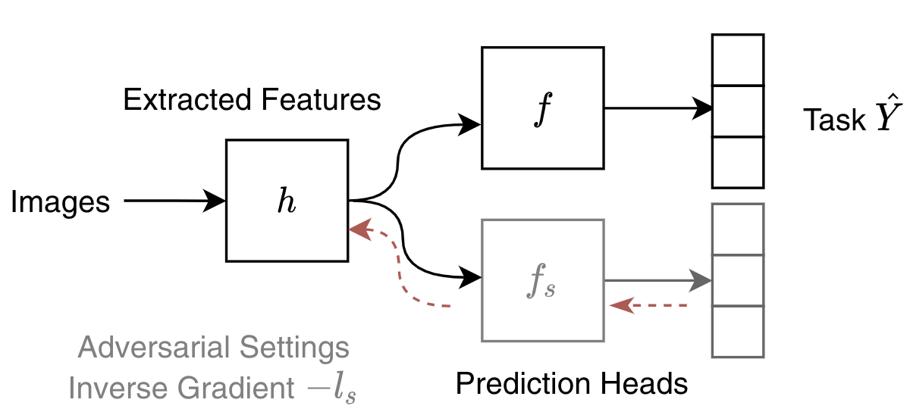
1.3 Motivation
Fairness through Blindness is a recent promising direction for mitigating unfairness in DNNs.
However, they may hurt the representation learning of the target task.
The models might consider combinations of other attributes as a proxy.
We introduce contrastive learning for blindness-based fairness algorithms.
[8] Tian et al. "Image fairness in deep learning: problems, models, and challenges." Neural Computing and Applications (2022): 1-19.
[9] Alvi et al. "Turning a blind eye: Explicit removal of biases and variation from deep neural network embeddings.” ECCVW. 2018.
Notes:
(click) Fairness through Blindness is a recent promising direction for mitigating unfairness in DNNs.
It’s achieved by complementing the target branch with a branch for classifying the sensitive attribute like gender or skin color.
(click) The framework captures semantic information to accurately perform the target task such as classification,
(click) while simultaneously minimizing the accuracy of the sensitive-attribute classifier. So that the model could learn a sensitive-attribute agnostic representation.
(click) However, some studies found these methods may hurt the representation learning of the target task.
(click) This is because after sensitive attribute information has been removed, the models might consider combinations of other attributes as a proxy and discard their information by mistake.
For example, lesion color and visual features are critical for skin lesion classification but are also useful for predicting the individual's skin type
(click) To address this issue, we introduce contrastive learning to let the model retain discriminative semantic information about the target task.

Slide 7
1.4 Contributions
Propose a novel framework FairDisCo with disentangled representation learning and contrastive learning
Employ three fairness metrics to better compare models
FairDisCo: Fairer AI in Dermatology
Examine unfairness in skin lesion datasets using a variety of approaches and extensive experiments.
FairDisCo achieves the best classification accuracy and fairness scores
Notes:
Therefore, in this work
(click) We propose a novel framework FairDisCo, featuring disentangled representation learning and contrastive learning, to promote fairness and boost classification accuracy.
(click) To the best of our knowledge, we are the first to examine unfairness in skin lesion datasets using a variety of approaches and extensive experiments.
(click) We also employ three fairness metrics to better compare models, including two that we adapted from the binary sensitive attributes task.
(click) Finally, our FairDisCo achieves the best classification accuracy and fairness scores compared to other fairness-based methods and the baseline.

Slide 8
Content
1
Introduction
2
Methodology
3
Experiments
4
Conclusion
Notes:
The next is the methodology part

Slide 9
2.1 Task & Overview
Multi-class Skin Lesion Classification
Available Data
RGB skin image X
Skin condition y
Skin type s
Goal
Model p(y|X) without being affected by s
Fairness Methods
FairDisCo
Pre-processing: Reweighting, Resampling
In-processing: Attribute-aware
Baseline
Notes:
(click) In the multi-class skin lesion classification task, the model is required to output a skin condition prediction based on an RGB skin image,
(click) and our goal is to model the likelihood without being affected by the skin type.
(click) We will introduce the proposed FairDisCo and three simple but widely used fairness approaches: Reweighting, Resampling, and Attribute-aware

Slide 10
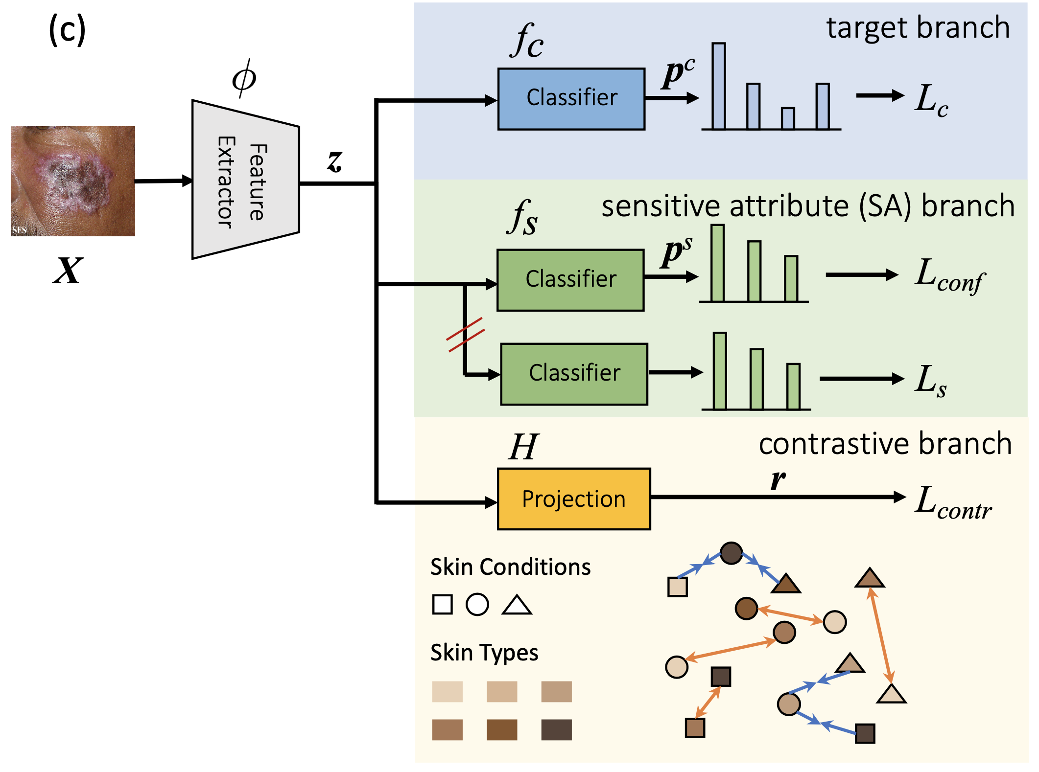
2.2 FairDisCo
Target branch: predicts the skin condition
Sensitive attribute branch: decouples the skin-type information from the representation
Contrastive branch: enhances feature extraction
Notes:
The intuition behind FairDisCo is to train a model to avoid capturing spurious correlations between skin conditions and skin types, and at the same time to learn semantic information from images. To achieve that, we incorporate three branches following a feature extractor
(click) The target branch predicts the skin condition as the baseline’s classifier does
(click) The sensitive-attribute branch decouples skin-type information from representations
(click) The contrastive branch enhances feature extraction
I’ll introduce the sensitive and the contrastive branches in detail.

Slide 11
2.2 FairDisCo
Disentangled Representation Learning
Remove the skin type information from the representation
Avoid the sensitive classifier to find a tricky solution
Notes:
The sensitive attribute branch contains a classifier to predict the skin type based on the representation.
(click) We use a confusion loss on this branch to remove the skin type information from the representation. It calculates a logarithm on each position in the prediction vector and then takes an average on them. When minimizing the loss, the network is enforced to estimate equal probability for all skin types, which means the representations are free of skin-type information.
We also need to notice that the sensitive-attribute branch might find a tricky solution like setting all the weights to zero, then the classifier output is a zero vector, and the confusion loss becomes the smallest even though the representation still contains skin-type information.
(click)To avoid this issue, we add a skin type predictive cross entropy loss only optimizing the classifier.

Slide 12
2.2 FairDisCo
Contrastive Feature Extraction Enhancement
Protect features and improves the representation learning
Cosine Similarity
Positive set P_{y} , Negative set N_{y}
Final Loss Function
Notes:
Although disentangled representation learning keeps the feature extractor blind to the skin-type information, it might hurt the extractor to encode semantic information by discarding important features related to the target task that could indicate skin type.
(click) Thus we add a contrastive loss that promotes intra-class cohesion and inter-class diversity to protect target features and improve the representation learning.
(click) we project representations into a low dimentional latent space
(click) and then calculate a supervised contrastive loss.
(click) The numerator is the similarity between samples in the same skin condition class
(click) and the denominator is a summation of similarities between samples in different classes. By minimizing this loss,
(click) the network is enforced to keep as many factors to push samples in the same class together and push away those in other classes without considering different skin types.
(click) Finally, our total loss function contains 4 items. We use alpha and beta to adjust contributions of confusion loss and contrastive loss.

Slide 13
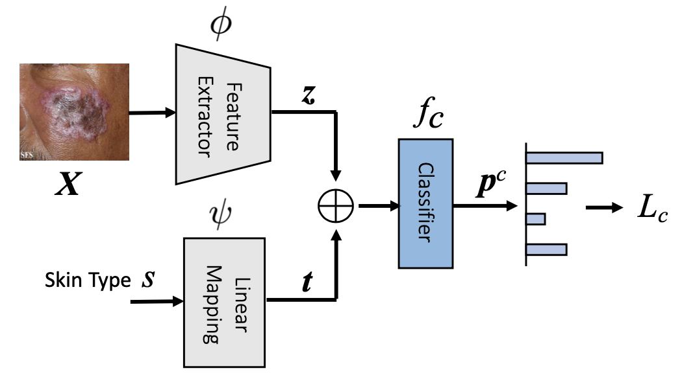
2.3 An Investigation of Three Algorithms
Reweighting algorithm makes skin condition and skin type independent
Resampling algorithm creates a balanced dataset
Attribute-aware algorithm adds skin type information to the model
Notes:
To better understand the unfairness issue and enrich our assessment of different fairness models, we study three widely used pre-processing and in-processing fairness algorithms.
(click) Reweighting algorithm tries to make skin condition and skin type independent
(click) The expected probability of one group is a multiplication between the probabilities of the skin condition group and the skin-type group.
(click) However, we usually observed a lower probability due to the correlation between two attributes.
(click) To cut off the connection between them, we assign each sample a weight that is the ratio of expected to observed probability and multiply it with the cross entropy loss
(click) Resampling algorithm considers samples in the same skin type and condition are in the same group and then oversamples minorities and undersamples majorities to create a balanced dataset. We set the sampling weight for each group as their inverse frequ (click) Attribute-aware Algorithm adds skin-type information to the model so that its prediction will not be dominated by major groups.

Slide 14
Content
1
Introduction
2
Methodology
3
Experiments
4
Conclusion
Notes:
The third part is experiments

Slide 15
3.1 Datasets & Metrics
Datasets
Fitzpatrick17k
~17k samples, 3 skin conditions, 6 Fitzpatrick skin types
Diverse Dermatology Images (DDI)
656 samples, 2 skin conditions, 3 skin types
Metrics
Accuracy
Fairness Scores
Predictive Quality Disparity (PQD)
Demographic Disparity (DP)
Equality of Opportunity (EO)
Notes:
(click) We study two skin lesion datasets: Fitzpatrick17k and Diverse Dermatology Images (DDI)
(click) We use accuracy to measure models' skin condition classification performance.
(click) To quantify fairness, we adapt earlier fairness metrics, which were restricted to binary classification or binary sensitive attributes to our multi-class classification and multiple sensitive attributes task
(click) Predictive Quality Disparity measures the prediction quality difference between each sensitive group
(click) Demographic Disparity computes the percentage diversities of positive outcomes for each sensitive group
(click) Equality of Opportunity claims that different sensitive groups should have similar true positive rates. We calculate DPM and EOM across multiple skin conditions

Slide 16
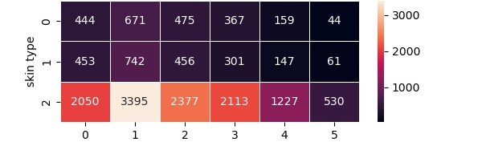
3.2 Results on the Fitzpatrick17k
Data Statistics
Numerous data biases occur in skin type and skin condition.
Task
In-domain Classification
Train set (~13k), test set (~3k)
Out-of-domain Classification
Experiment A: Trains models on type 1-2 (~7k), tests on others (~8k)
Experiment B: Trains models on type 3-4 (~6k), tests on others (~10k)
Experiment C: Trains models on type 5-6 (~2k), tests on others (~14k)
Notes:
(click) On the Fitzpatrick17k dataset, we first implemented the data statistics. Numerous data biases occur in skin type and skin condition.
(click) We follow Groh et al’s work to conduct two tasks on this dataset. For the in-domain classification, we randomly split the train and test sets. For the out-of-domain classification, we set three experiments, each of them trains models on two skin types and test them on other skin types.

Slide 17
3.2 Results on the Fitzpatrick17k
In-domain Classification Results
The baseline (BASE) exhibits inconsistent performance (accuracy) that varies across skin types.
The accuracy of the major skin-type group is lower than the underrepresented skin-type group.
Notes:
From the in-domain classification results, we make several observations.
(click) First, our baseline exhibits inconsistent accuracy that varies across skin types, showing the existence of skin-type unfairness.
(click) Second, we observe the phenomena mentioned in other papers where the accuracy of the major skin-type group like type 2 is lower than the underrepresented skin-type group like type 6. The ambiguous systematic pattern in accuracy across skin types could be seen in all the models in the table.

Slide 18
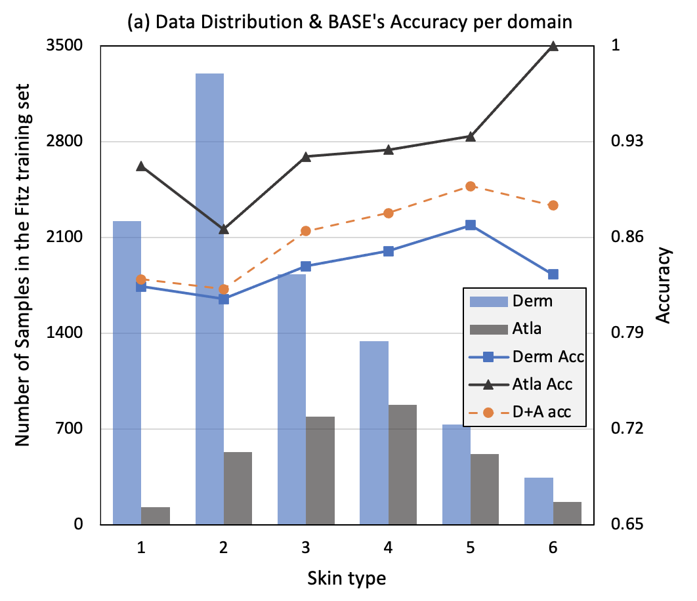
3.2 Results on the Fitzpatrick17k
Explanations for the inconsistent relationship between accuracy and skin type group size
Domain distribution diversity across domains.
Notes:
Here we analyze the data and try to give some explanations for this situation.
(click) The first reason is domain distribution diversity across domains. The Fitzpatrick17k dataset is collected from two domains: Derm and Atla. As illustrated in the figure,
(click) Derm has the most samples in type 2, the fewest in type 6, and a higher average accuracy,
(click) but Atla has the most in type 4, the fewest in type 1, and a lower average accuracy. The diversities of distribution and classification difficulty across domains conceal the real pattern when we directly train models on two domains and only report the overall accuracy.

Slide 19
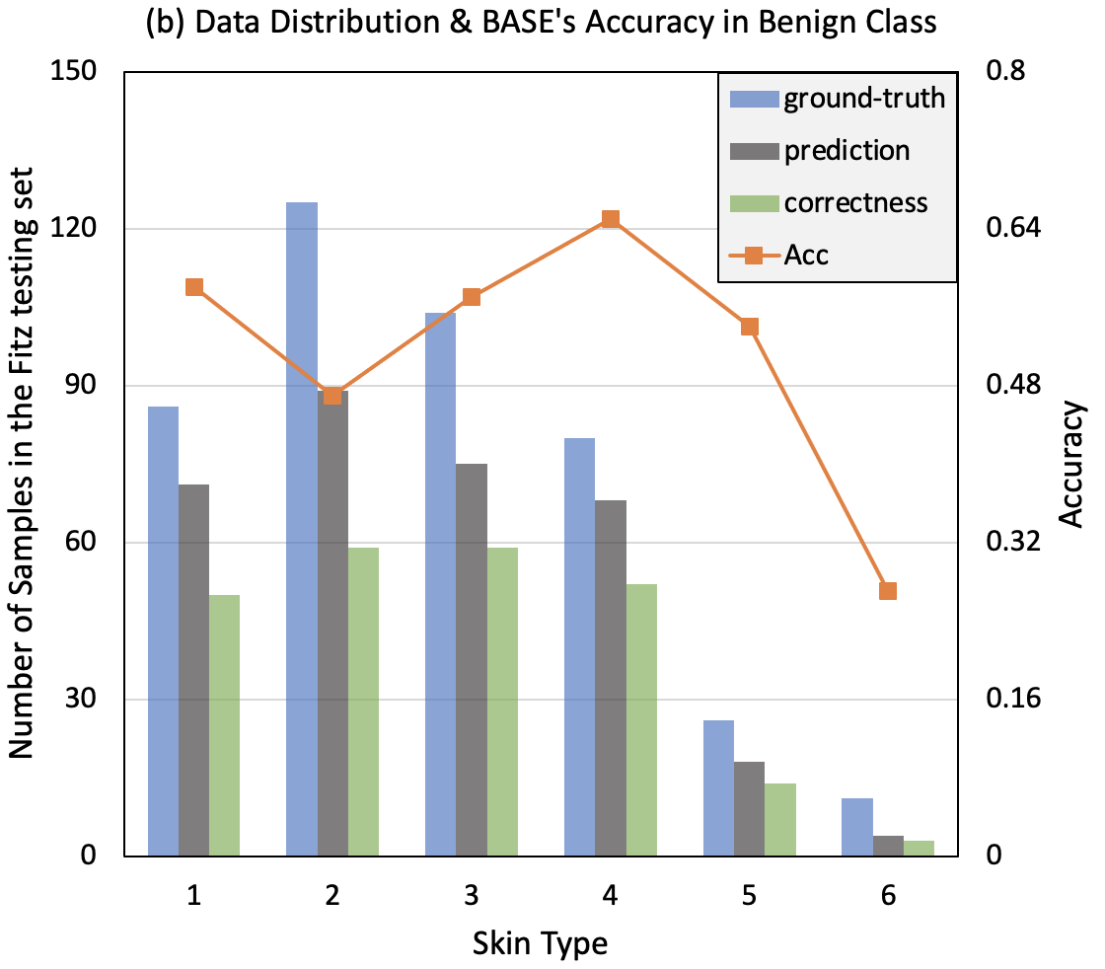
3.2 Results on the Fitzpatrick17k
Explanations for the inconsistent relationship between accuracy and skin type group size
Domain distribution diversity across domains.
Different diagnosis difficulties across skin types.
The possibly untrustworthy results for those groups with few test samples.
Notes:
(click) Besides, different diagnosis difficulties across skin types also causes the problem.
(click) The figure shows that the baseline‘s prediction and ground-truth in benign class have similar distributions. Type 2 has the most and type 6 has the least, indicating the model's prediction is affected by skin type.
(click) However, the correctness distribution is quite different. Type 2-4 have a similar number of correctness even though type 2 has more benign predictions. Then we could hypothesize the images in type 2 might be more challenging to classify than those in type 4 and 5, confusing the relationship between accuracy and statistical data distribution.
(click) Third, the small group size might make the test results unreliable. In our test set, some groups only have a few samples. Thus a correct or wrong prediction will significantly impact their accuracy, making the results of underrepresented groups untrustworthy.

Slide 20
3.2 Results on the Fitzpatrick17k
In-domain Classification Results
Fairness methods show a promising performance compared with the baseline.
FairDisCo achieves the highest accuracy and fairness scores. It also outperforms FairDisCo without the contrastive branch, showing the effectiveness of contrastive learning.
Notes:
Come back to the in-domain classification results.
(click) We could find Fairness methods show a promising performance compared with the baseline.
(click) In addition, FairDisCo achieves the highest accuracy and fairness scores. It also outperforms FairDisCo without the contrastive branch, showing the effectiveness of contrastive learning.

Slide 21
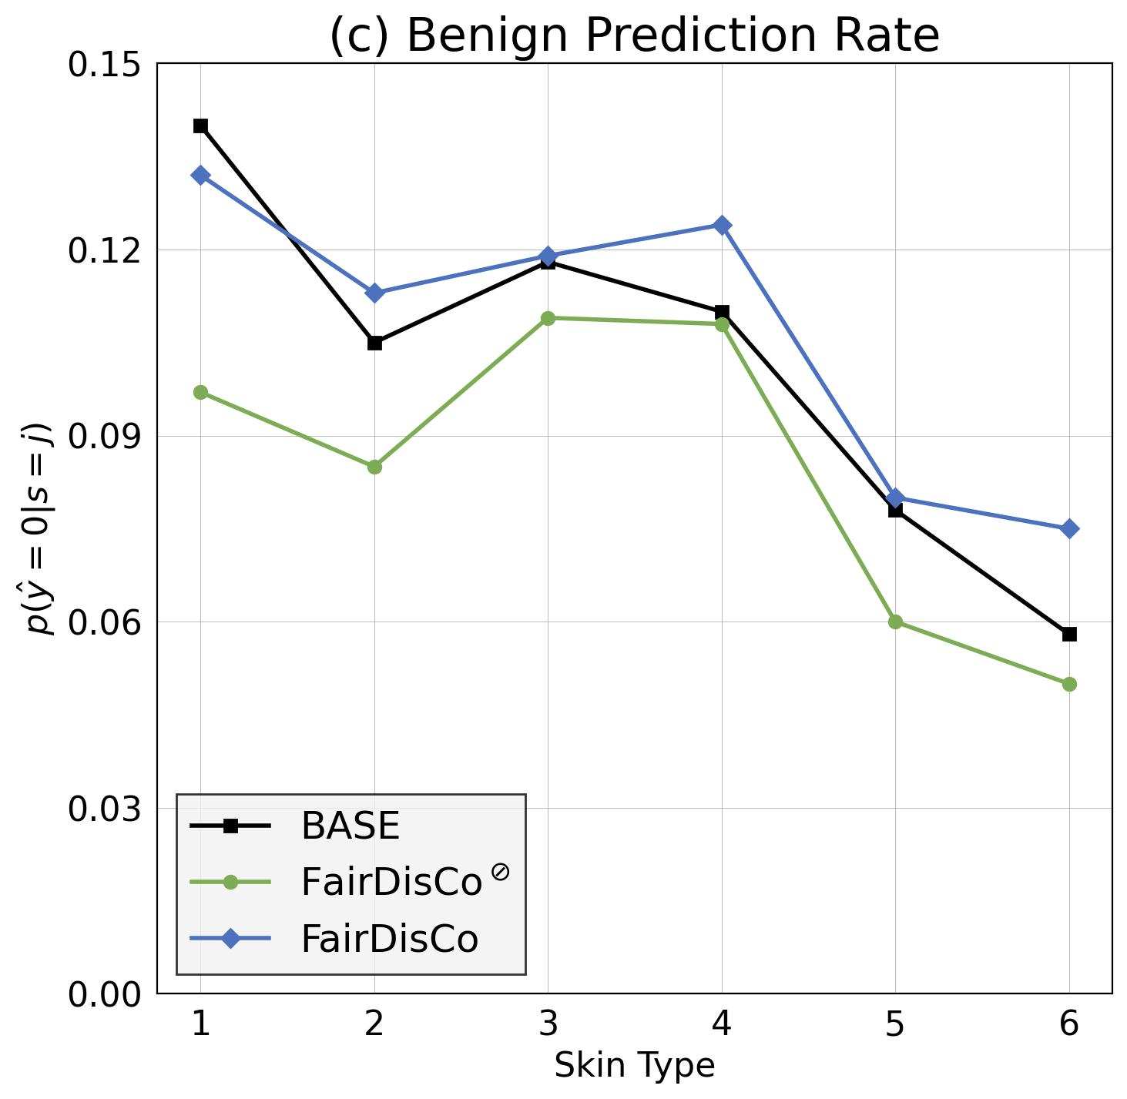
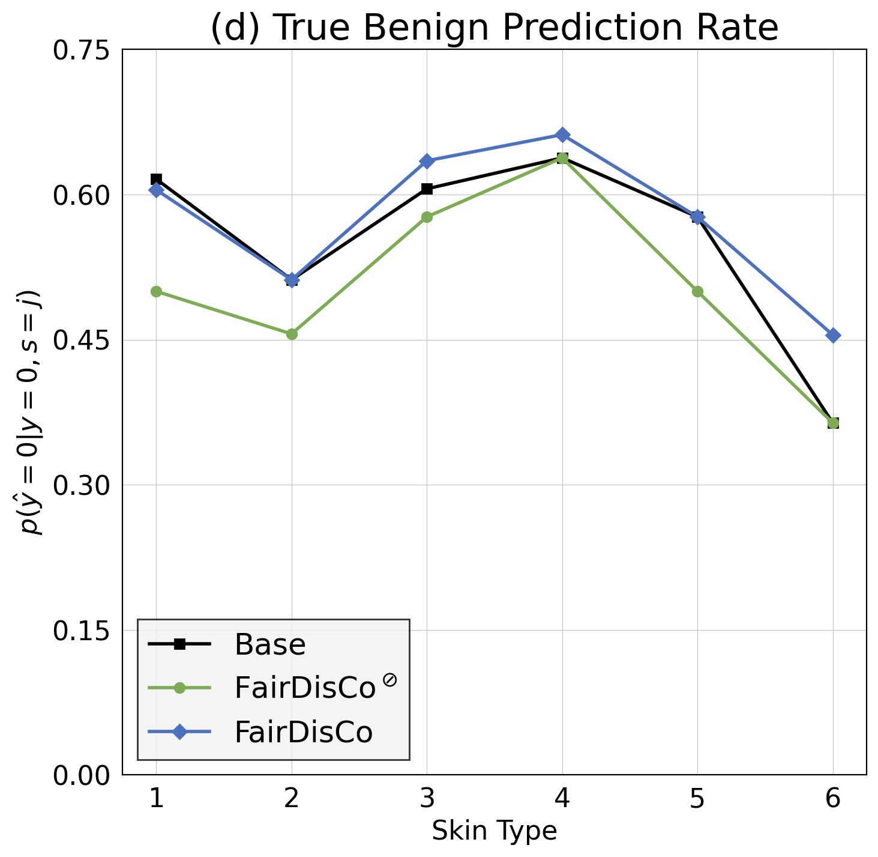
3.2 Results on the Fitzpatrick17k
Visualization of the main terms of fairness scores on the benign class
Benign Prediction Rate for calculating DPM, True Benign Rate for calculating EOM.
BASE has diverse values across skin types.
FairDisCo mitigates the variations across skin types.
Notes:
We further visualize the main terms of fairness scores on the benign class
(click) The following two figures show that the baseline has diverse values across skin types, indicating the model is affected by skin-type information.
(click) However, FairDisCo presents little variation across skin types and boosts the minor skin-type group's benign prediction rate and true benign rate, showing our model reduces skin-type unfairness

Slide 22
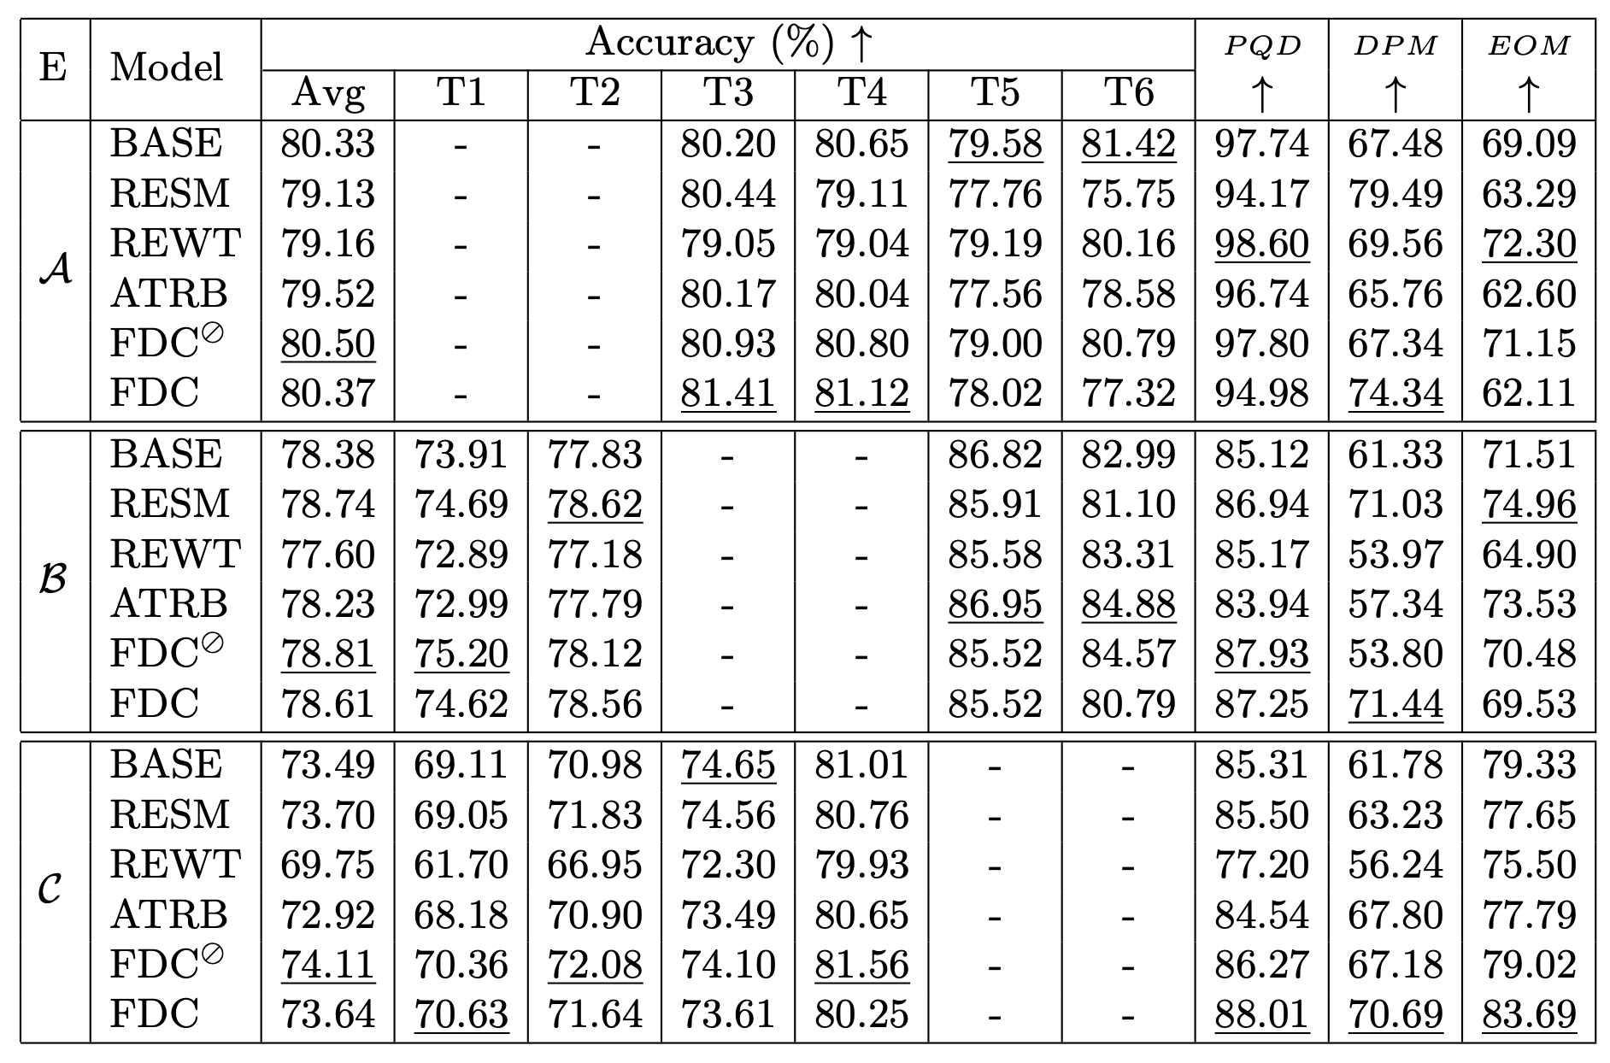
3.2 Results on the Fitzpatrick17k
Out-of-domain Classification Results
BASE has higher accuracy on those skin types similar to those it is trained on. This reveals the model's decision-making is relevant to the skin type.
FairDisCo is the second-best among all the algorithms. Its inferior performance may be because the contrastive loss only helps to learn better representations of skin-type groups appearing in the training set.
Notes:
Another task on the Fitzpatrick17k is the out-of-domain classification.
(click) From the table, we could find the baseline has higher accuracy on those skin types similar to those it is trained on. This reveals the model's decision-making is relevant to the skin type.
(click) In addition, FairDisCo is the second-best among all the algorithms. We think its inferior performance compared with FairDisCo without contrastive learning is because the contrastive loss only helps to learn better representations of skin-type groups appearing in the training set. However, the out-of-domain classification task has a large diversity across skin types between the training and test sets.

Slide 23
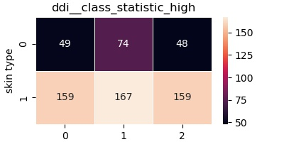
3.3 Results on the DDI
Data Statistics
Similar skin-condition data imbalance but less skin-type bias
In-domain Classification
Train set (524), test set (132)
Notes:
(click) For the DDI dataset, we also analyze the data first. It contains similar skin-condition data imbalance like the fitzpatrick17k dataset but less skin-type bias.
(click) We follow Daneshjou et al’s work to conduct an in-domain classification task.

Slide 24
3.3 Results on the DDI
In-domain Classification Results
For BASE, the major skin-type group (T34) is more accurate than the minor groups (T12 and T56).
All the fairness approaches except ATRB outperform the baseline.
FairDisCo achieves the best classification performance and achieves the best fairness results.
Notes:
In this experiment, we further add area under the ROC curve to measure the classification performance.
(click) For the baseline, the major skin-type group (T34) is more accurate than the minor groups (T12 and T56), showing it ignores the underrepresented groups.
(click) Besides, all the fairness approaches except attribute-aware algorithm outperform the baseline.
(click) And our model FairDisCo achieves the best classification performance and fairness results. Its superior performance compared with FairDisCo without contrastive learing further demonstrates that the contrastive loss plays an important role in learning a better semantic representation.

Slide 25
Content
1
Introduction
2
Methodology
3
Experiments
4
Conclusion
Notes:
The final part is the conclusion

Slide 26
4.1 Conclusion
Improved the fairness and boosted the classification accuracy by proposing FairDisCo
FairDisCo achieved the best overall accuracy and fairness on in-domain classification tasks
FairDisCo: Fairer AI in Dermatology
Our results indicate that the datasets have skin-type bias, and fairness methods could diminish the discrimination
Compared the baseline and FairDisCo to 3 widely used fairness techniques
Proposed three fairness metrics and conducted extensive experiments
Notes:
In this work,
(click) We improved the fairness and classification accuracy by proposing a novel deep neural network, FairDisCo,with disentangled contrastive learning.
(click) Besides, we Compared the baseline and FairDisCo to 3 widely used fairness techniques (reweighting, resampling, and attribute-aware).
(click) We also proposed three fairness metrics for our task which could also be applied to other fairness tasks and conducted extensive experiments on two datasets.
(click) Our results indicate that the datasets have skin-type bias, and fairness methods could diminish the discrimination.
(click) Finally, our proposed model FairDisCo achieved the best overall accuracy and fairness on in-domain classification tasks and surpassed the baseline on the out-of-domain classification task.

Slide 27
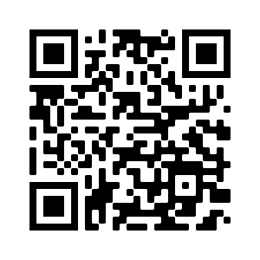
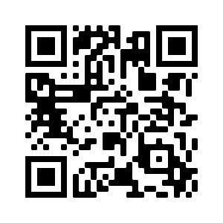
FairDisCo: Fairer AI in Dermatology via Disentanglement Contrastive Learning
Paper is available at
Code is available at
Thank you!
Contact us: {siyi, bhers, nourhanb, rafeef}@ece.ubc.ca, hamarneh@sfu.ca
Notes:
That's all. Here are our paper and code links. Thank you for your listening.
paper https://arxiv.org/abs/2208.10013
code https://github.com/siyi-wind/FairDisCo

